Slide 1
WHY ROLL THE DICE?

Slide 2
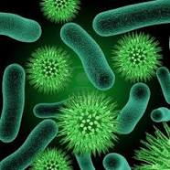
DON’T TAKE THE RISK: INFECTIONS
A bacterial infection is a proliferation of a harmful strain of bacteria on or inside the body. Bacteria can infect any area of the body. Pneumonia, meningitis, and food poisoning are just a few illnesses that may be caused by harmful bacteria. Bacteria come in three basic shapes: rod-shaped (bacilli), spherical (cocci), or helical (spirilla). Bacteria may also be classified as gram-positive or gram-negative. Gram-positive bacteria have a thick cell wall while gram-negative bacteria do not. Gram staining, bacterial culture with antibiotic sensitivity determination, and other tests are used to identify bacterial strains and help determine the appropriate course of treatment.

Slide 3
BE CAREFUL: PREVENTION
According to Centers for Disease Control and Prevention you should follow these advices to prevent infections:
Hygienical advices
The most important thing for prevention is the hygiene. According to the CDC you should wash your hands a lot of times during the day because there are a lot of bacteria on them. The most efficient way to kill bacteria is to use soap or an alcohol solution.
A lot of people thinks that it doesn’t change anything between one or another cooking mode but this isn’t true. You should ALWAYS be sure that the meet is well-done because you can contract an illness from raw meet.

Slide 4
HYPERSENSITIVITY REACTIONS
Certain human disorders are attributed to activity of the immune system. These disorders are commonly known as hypersensitivities, states of increased immune sensitivity that are mediated by antibody or cellular factors.
If the activity of the immune system is excessive or over-reactive, a hypersensitivity reaction develops.
Most injury resulting from hypersensitivities develops after an interaction has taken place between antigens and antibodies or between antigens and sensitized T-lymphocytes.
When T-lymphocytes are involved, the reactions are characterized as delayed hypersensitivity. Immediate hypersensitivity reactions include anaphylaxis, allergic reactions, cytotoxic reactions, and immune complex reactions. Delayed hypersensitivity reactions are generally characterized as contact dermatitis or infection allergies.

Slide 5
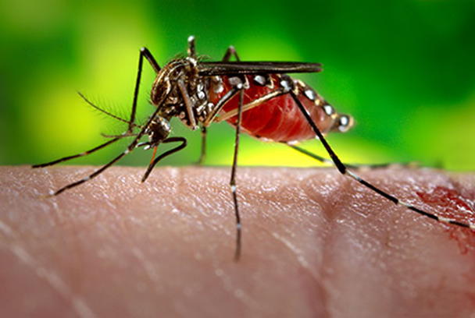
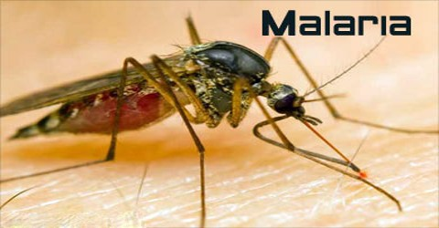
SOME EXAMPLES
ZIKA VIRUS
MALARIA
Zika is an infected Aedes species mosquito that can bite during the day and the night. Zika virus transmission has been reported mostly in the South- America since 1947.
Malaria is the most ommon among all parasites with its clinical picture of acute febrile illness that manifests itself with signs of different severity depending on the infectious species

Slide 6
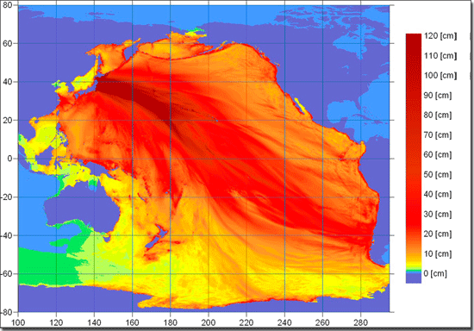
WHAT IS A TSUNAMI?
The tsunami is an anomalous wave motion of the sea, originated from an earthquake submarine or near the coast.
The intensity of a tsunami depends on the amount of water displaced at the time of the tsunami itself, which can be assessed when the wave reaches the shores: in general a tsunami wave that does not exceed 2.5 m in height along the coast it will cause great damage and its effects will not be dangerous, while a wave of over 4-5 m in height will be destructive to the invested coast.

Slide 7
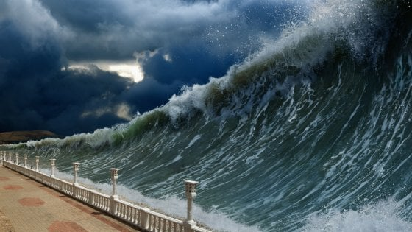
PROPAGATION
When a tsunami originates and spreads near the coastline, it is defined as local. Other tsunami can instead propagate for thousands of kilometers crossing entire oceans: these are generally of tectonic origin.
The speed of propagation of the tsunami wave in the high ocean is high, of the order of hundreds of kilometers per hour, being able to reach 500-1000 km/ h.
If the fracture of the earth's crust is extended by tens, hundreds, or even thousands of kilometers, plane waves tend to generate lower attenuation than spherical or circular waves: they are able, therefore, to cover considerably greater distances until they cross whole oceans.

Slide 8
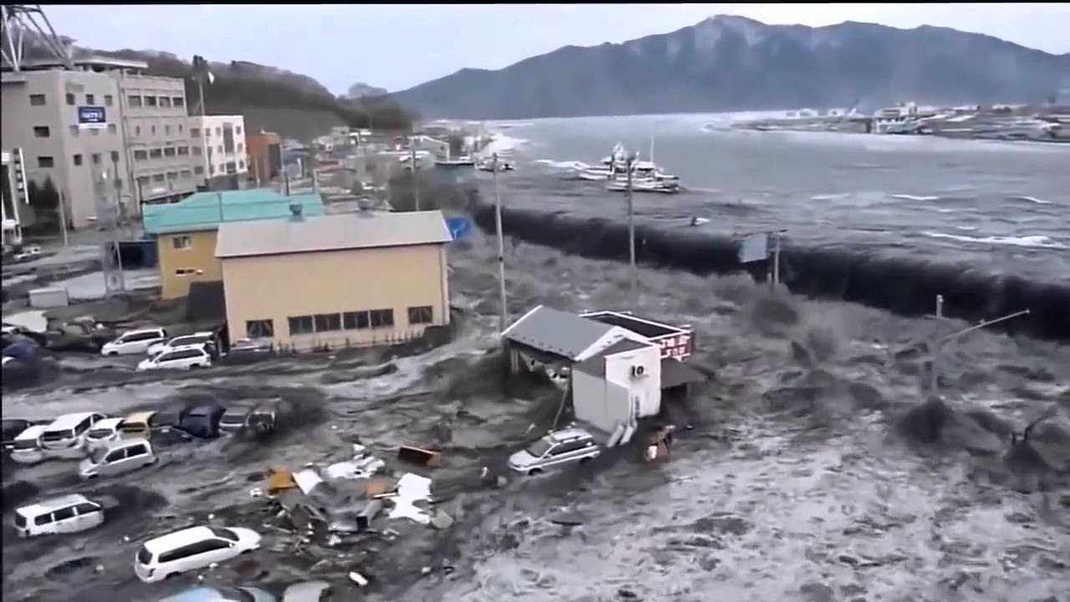
INFRANGEMENT
Once generated, the tsunami wave energy is constant and a function of its height and speed, except for the aforementioned attenuations.
When the wave approaches the coast it meets an ever lower sea bed and slows down its front due to the friction with the ocean bottom becoming shorter and, due to the principle of conservation of the 'energy, the causes a transformation from kinetic energy to potential energy.
A tidal wave can be devastating, because the amount of water that it carries immediately behind the wave front allows it to spill up to hundreds of meters (sometimes even for kilometers) inland. The penetration into the hinterland is clearly facilitated if the surface is flat and without natural barriers such as hills.

Slide 9
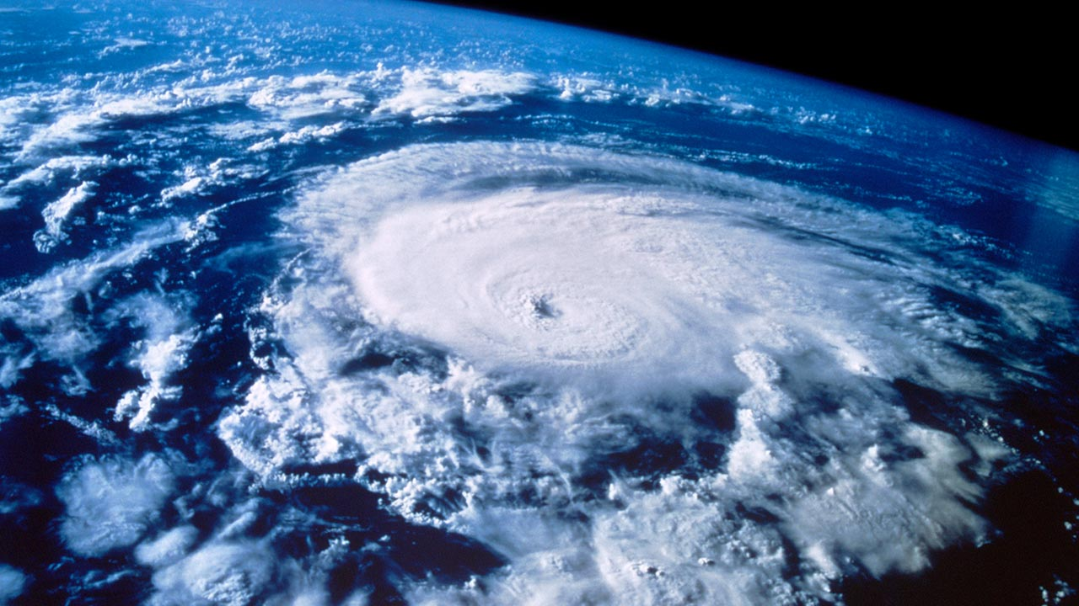
HURRICANS
The Hurricane is certainly the worst meteorological phenomenon that can be encountered. It is not by chance that the origin of the term derives from the Caribbean word "hurrican" which in indigenous indicates the God of evil. So from ciche its strength exceeds any flood or earthquake. The hurricane where it passes leaves no trace. The power of hurricanes and cyclones is measured by the Saffir-Simpson scale, named after the Americans Herbert Saffir and Robert Simpson who conceived it in 1969.

Slide 10
DIFFERENT CATEGORIES
It is made up of 5 categories that, based on the wind speed generated by the hurricane, give a measure of the possible devastation that the phenomenon will produce. Here are the 5 categories in which hurricanes are divided:
Category 1 - winds range from 118 to 153 km / h. Damages are limited to boats, trees, roofs, with possible flooding in coastal areas.
Category 2 - winds range from 154 to 177 km / h, the damage worsens and it may be necessary to evacuate people living on the coast.
Category 3 - winds range from 178 to 209 km / h, damage also affects homes. The coastal areas can be submerged by high water up to 4 meters the normal.
Category 4 - winds range from 210 to 240 km / h and serious damage to houses occurs. Coastal flooding can exceed 6 meters beyond the usual level. in addition to the population living on the coast it may also be necessary to move the inhabitants within 10 km from the sea.
Category 5 - is the most devastating, with winds exceeding 250 km / h. The buildings are demolished and the floods on the coast are very serious. The inhabitants within 16 km of the coast must leave their homes.

Slide 11
HURRICAN KATRINA
Hurricane Katrina was one of the five most serious hurricanes in the history of the United States, the most serious in terms of economic damage and one of the most serious in terms of the number of deaths. It formed above the Bahamas on 23 August 2005 and traversed south Florida as a category 1 hurricane, causing some deaths and flooding, becoming one of the strongest hurricanes ever recorded at sea. All this to remember that nature has in our hands all our life, our whole existence. It does not explain why so much ferocity, perhaps if we tried to be less cruel towards him, not destroying the planet, there would be less catastrophes, perhaps even less diseases and certainly we would live better.

Slide 12
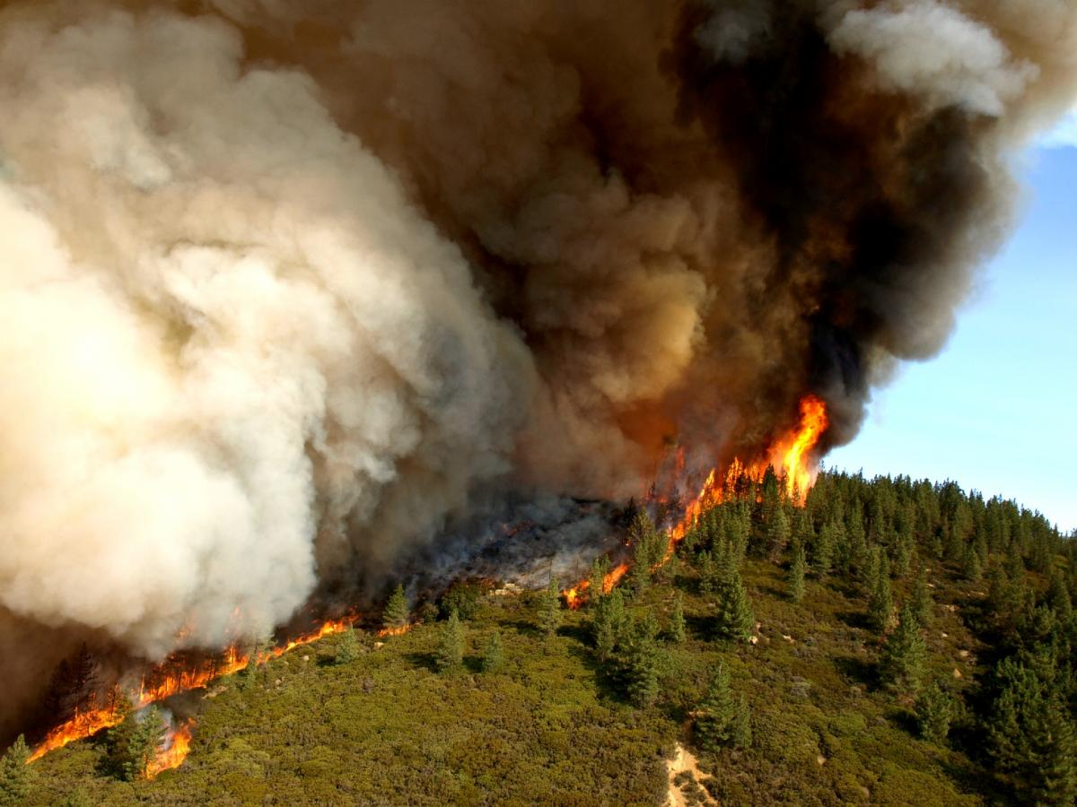
WHAT IS A CONFLAGRATION?
A conflagration is a large and destructive fire that threatens human life, animal life, health, and/ or property.
It mayy also be described as a blaze or simply a fire.
A conflagration can begin acidentaly, be naturally caused or intentionally created (arson)

Slide 13
TYPES
Industrial conflagrations include fires at oil refineries, such as the 2009 Cataño oil refinery fire.
One or several fire(s) in forests or other wilderness areas, i.e. wildfire(s), may grow up into or unite to a conflagration.
An urban conflagration is defined as a "large, destructive fire that spreads beyond natural or artificial barriers; it can be expected to result in large monetary loss and may or may not include fatalities...An urban conflagration moves beyond a block and destroys whole sections of a city.“
In some ships, a large uncontained fire may quickly lead to a ship conflagration.
The conflagration of a building is known as a structure fire.
An asteroid more than 4.3 miles (6.9 km) in diameter colliding with the Earth, spewing out enough ejecta to cause a global conflagration.

Slide 14
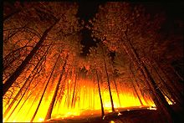
CAUSES
A conflagration can be caused by differents natural causes (gasses come from oraic materials, decomposition subordinateby high temperature, lightnings etc.) or human random causes, lawful or unlawful

Slide 15
CONFLAGARATION PHASES
Ignition: principal conflagaration’s phase, where combustible substances vapors, are them solid or liquid, begin the process of combustion and the combustion is easily controllable.f fuel involved;
Propagation: characterized by low temperatures and scarce quantity of fuel involved; the heat propagates the fire and a slow raising of the temperature determines hhim with issue of smokes;
Flash over: an abrupt raising of the temperatures and thick increase of the quantity of material that it participates in the combustion;
Generalized fire: the whole prsent material participates in the combustion, the temperature reaches elevated values and the combustion it is uncontrollable;
Excinction: final phase of conclusion of the combustion for exhaustion or suffocation;
Cooling: phase that behaves the cooling of the interested zone

Slide 16
Class name : 2A School name : Liceo scientifico ‘Alfano’ Termoli

