Slide 1
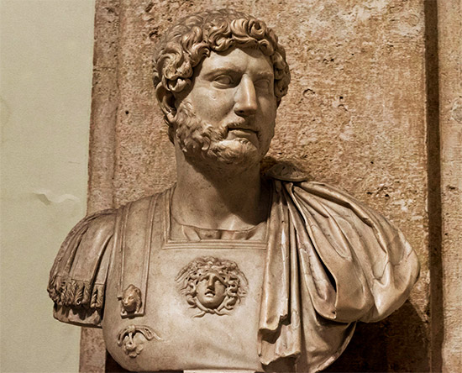
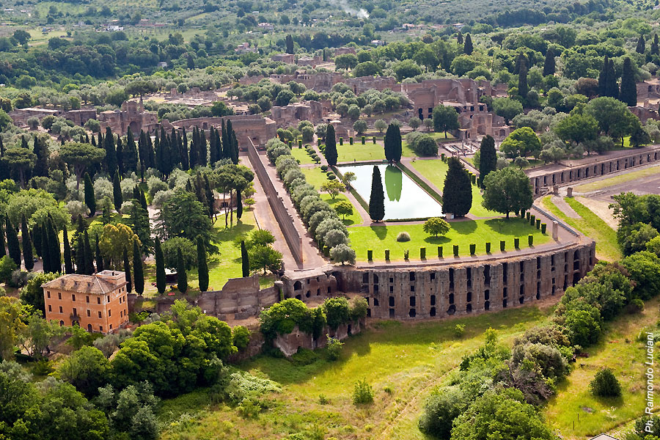
Emperor hadrian

Slide 2
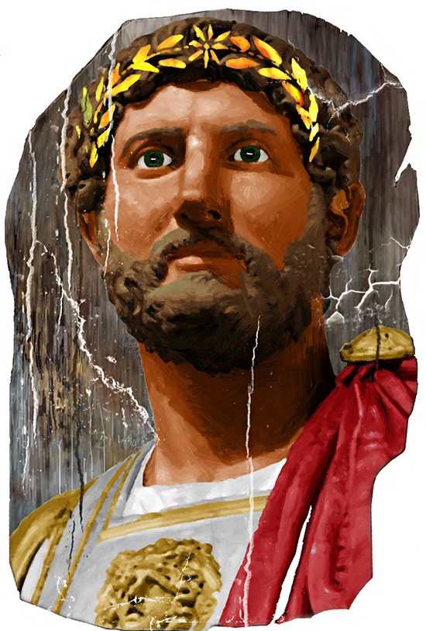
When ?
After the death of Trajan , in AD 117 Hadrian was declared emperor .
He was from Spain and when he ascended the throne he was forty years old. Hadrian died AD 138 at the age of 62.
His succesor was Antonino.
(Publius Aelius Traianus Hadrianus Augustus)

Slide 3
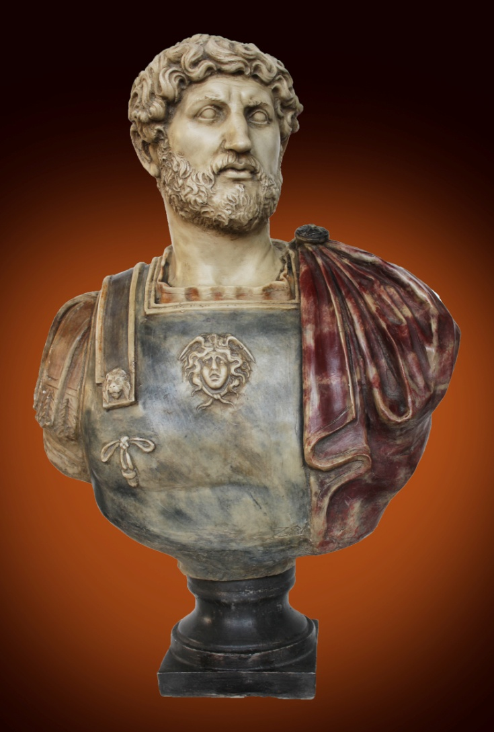
WHo?
He was a man of peace and an acute observer of situations.
He led the garrisons into victorious battles and studied all the necessary logistics with experts.
He was cultured and intellectual and he took care in creating a good, efficient and bureaucratic organization of the State.
(Bust of Hadrian)

Slide 4
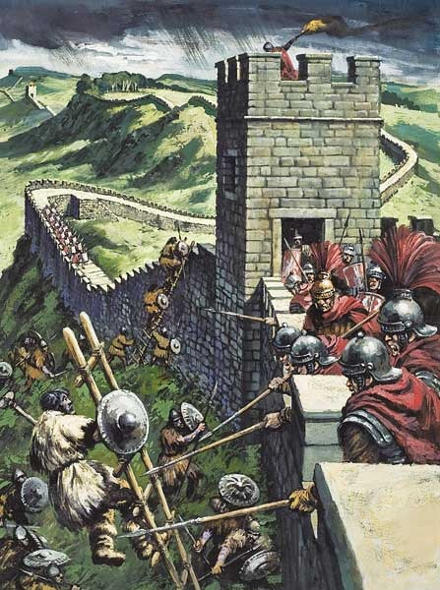
How?
Hadrian’s stategy was diffferent from that of Trajan because he chose to contain and defend the boundaries of the empire instead of concentrating on great project of battle.
(Defense of the empire in Hadrian’s wall )

Slide 5
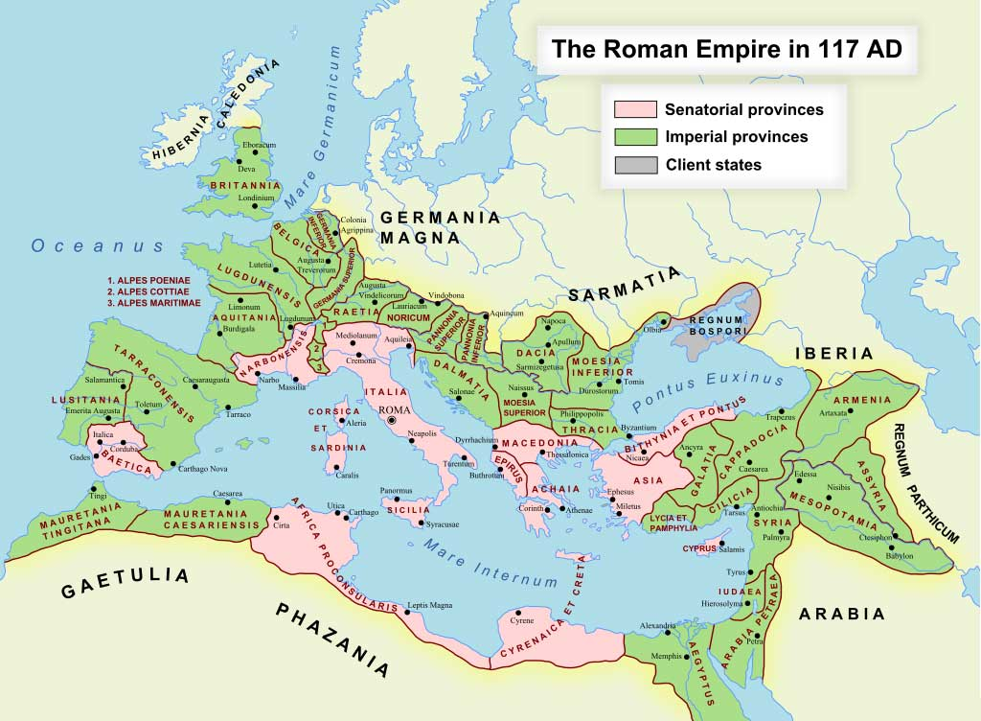
What?
He decided to resolve the military problems of the empire. Then he revisioned and simplified the laws and allowed bureaucratic mechanisms.
Four years after his coronation, he began to inspect personally the provinces of the empire taking long trips which lasted years.

Slide 6
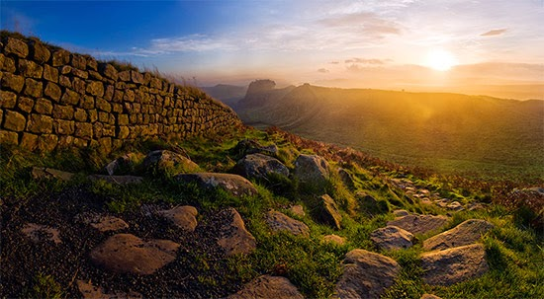
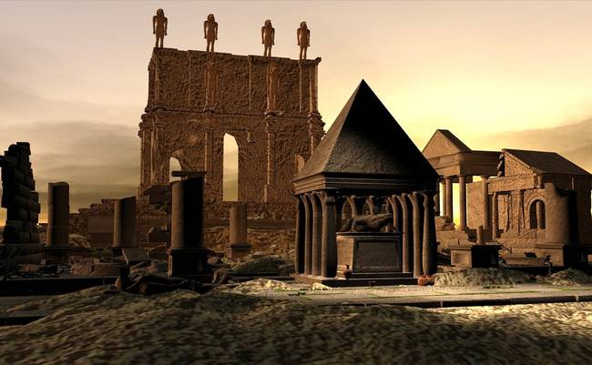
WHERE?
He built bridges and roads in Gaul, reorganized the garrisons in Germany and constructed a great defensive wall in Brittany.
In Egypt, he constructed Antinopolis, dedicated to the his favourite companion, Antinous.
(Hadrian’s wall , Brittany)
(Antinopolis,Egypt )

Slide 7
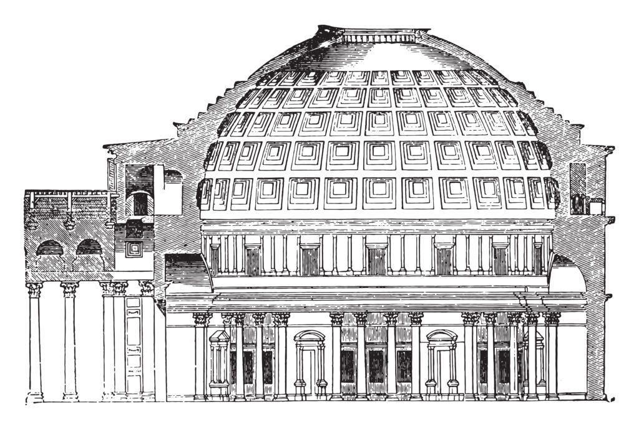
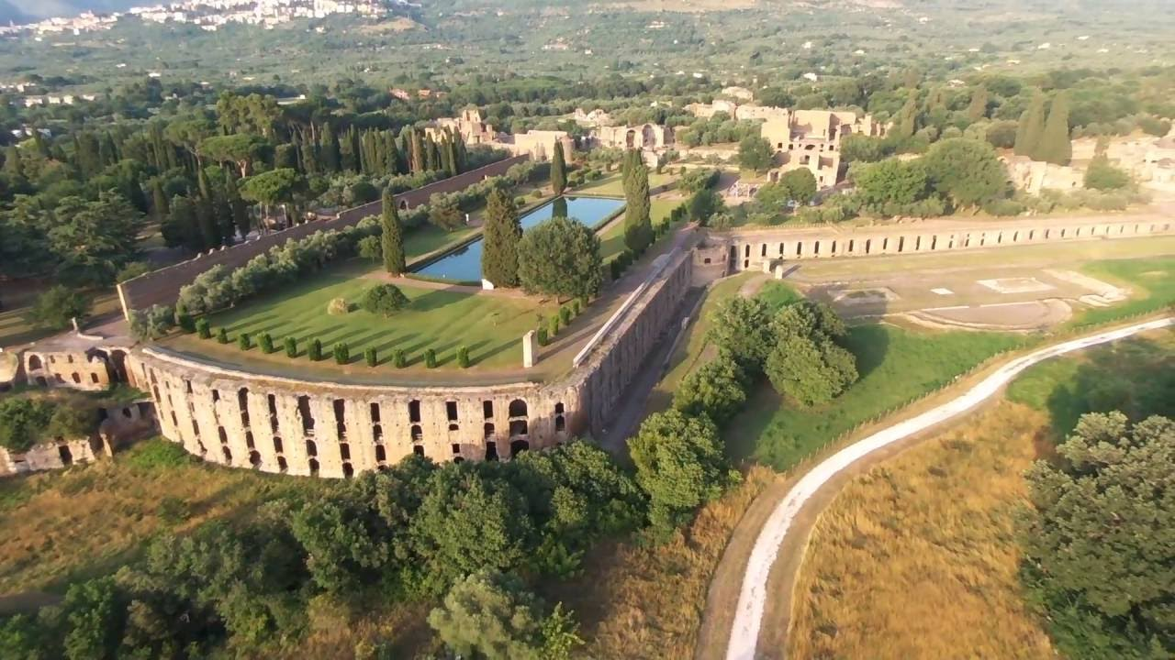
Hadrian is responsible for the rebuilding of the Pantheon, after its destruction by fire.
He also built the villa near Tivoli, a masterpiece for its architectural riches.
(Ancient Pantheon, Rome )
(Hadrian’s villa, Tivoli )

Slide 8
The end

Slide 9
this work has
been written by:
Alessia D’Onofrio
Michela Keratsas
Swami Mastronardi
Daniela Vicanolo
class: 1 A

