Slide 1
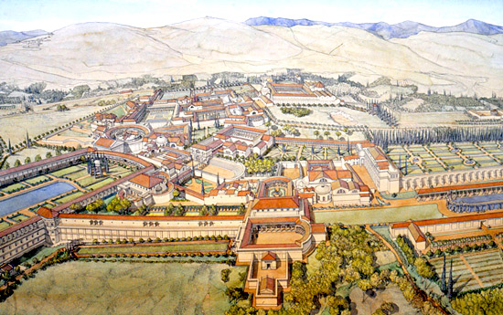
STRUCTURE AND ARCHITECTURE OF HADRIAN’S VILLA

Slide 2
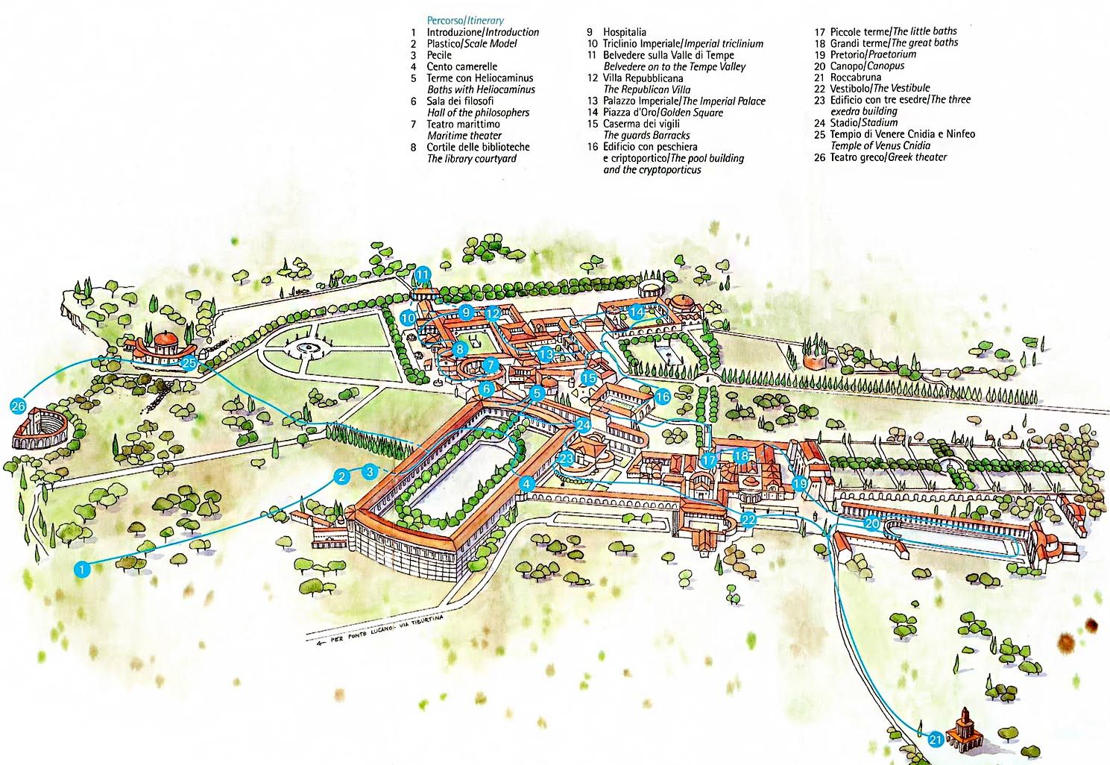
Hadrian’s villa stood on a hills, it was surrounded by two small streams and the hills behind Tivoli provided water for four of the aqueducts that supplied Rome.
The villa also included:
a garden with an elongated fountain and a view towards the valley
two buildings often identified as a greek library and a latin library
a large courtyard followed by the main residential part of the palace
further back was another grand court with a portico and richly adorned rooms, the so-called Golden Court due to the very rich finds from there.

Slide 3
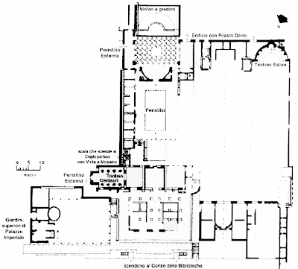

Slide 4
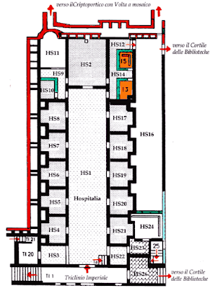
The buildings are constructed in travertine, brick, lime, pozzolana, and tufa.
The complex contains over 30 buildings, covering an area of at least 120 hectares of which much is still unexcavated.
The site was chosen due to its abundant waters and readily available aqueducts that passed through Rome, including Anio Vetus, Anio Nobus, Aqua Marcia, and Aqua Claudia.

Slide 5
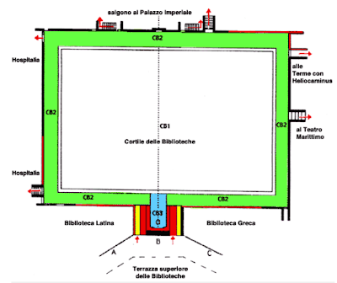
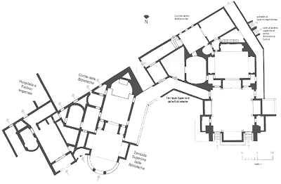

Slide 6
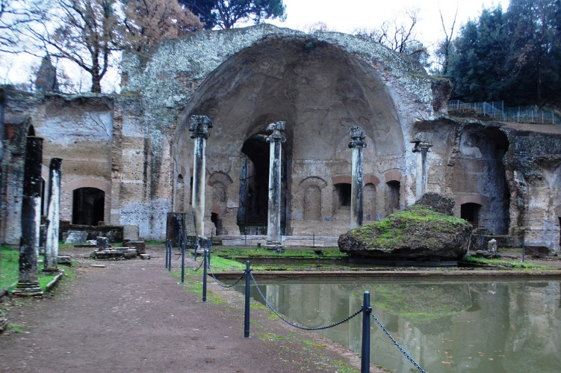
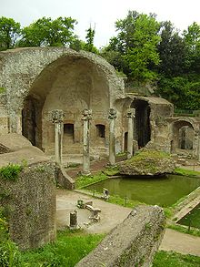
One of the most striking and best preserved parts of the Villa consists of a pool named Canopus and an artificial grotto named Serapeum.
The pool measured 119 by 18 metres (390 by 59 ft). Each column surrounding the pool was connected to each other with marble.
Hadrian's Pecile located inside the Villa was a huge garden surrounded by a swimming pool and an arcade. The pool's dimensions measure 232 by 97 metres (761 by 318 ft).

Slide 7
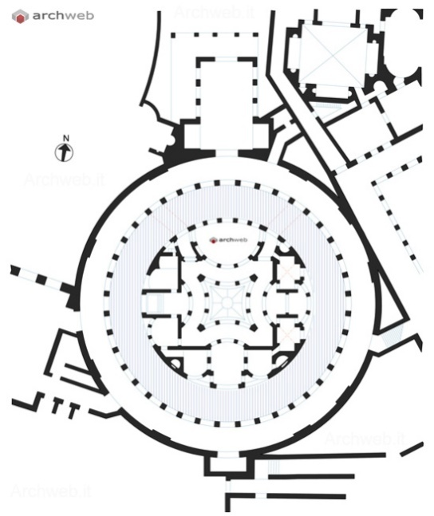
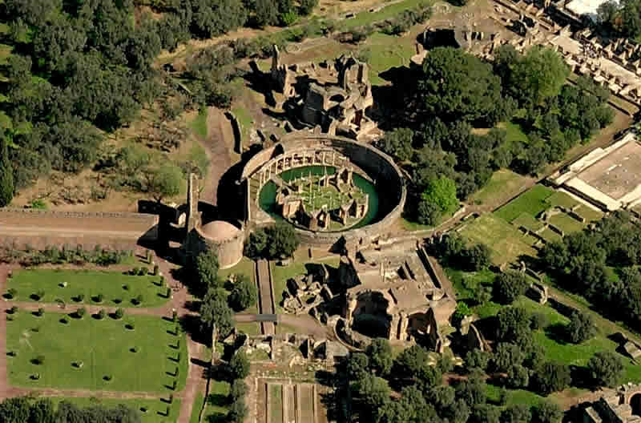
One structure in the villa is the so-called "Maritime Theatre".
It consists of a round portico with a barrel vault supported by pillars.
Inside the portico was a ring-shaped pool with a central island. The large circular enclosure 40 metres (130 ft) in diameter has an entrance to the north.
The Maritime Theater includes a lounge, a library, heated baths, three suites with heated floors, washbasin, an art gallery, and a large fountain.
(The island was problably used by the emperor as a retreat from the busy life at the court).

Slide 8
The villa utilizes numerous architectural styles and innovations.
The domes of the steam baths have circular holes on the apex to allow steam to escape.

Slide 9
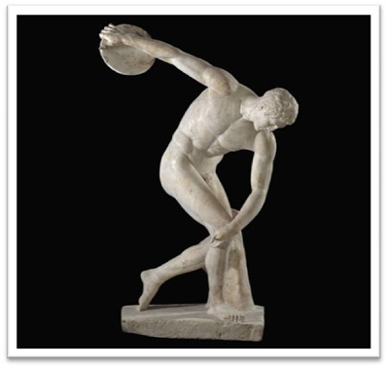
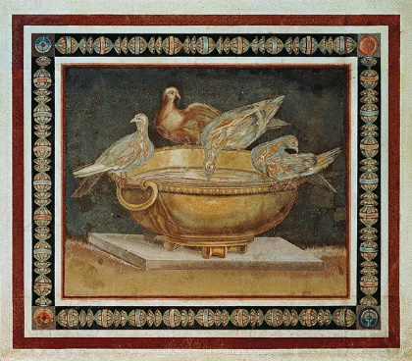
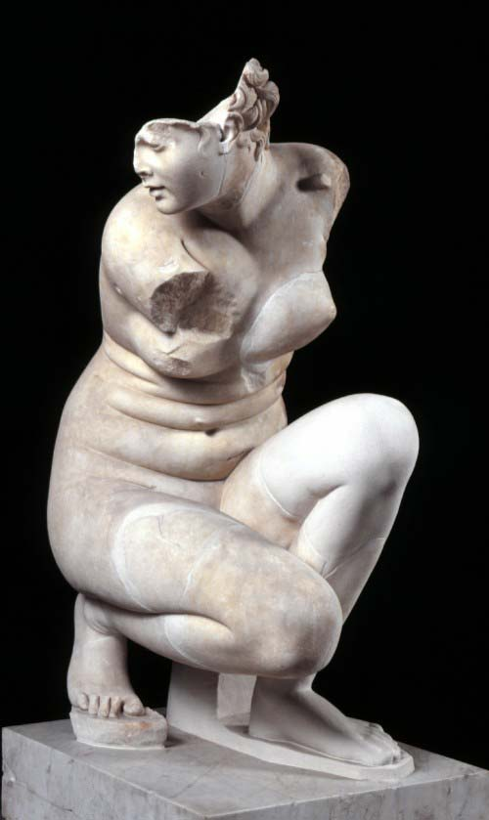
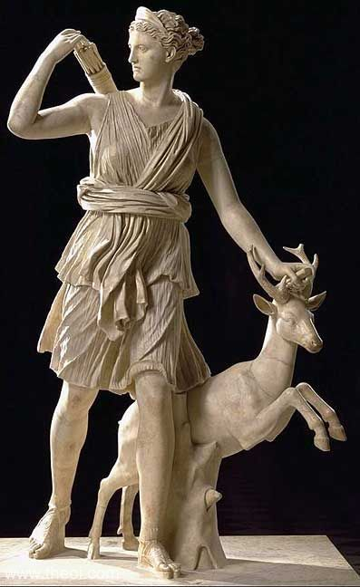
ARTWORKS FOUND IN THE VILLA INCLUDE:
Discobolus
Dove Basin mosaic, copy of a famous Hellenistic mosaic, Capitoline Museums
Diana of Versailles, Louvre
Crouching Venus
Capitoline Antinous
Young Centaur and Old Centaur (Capitoline versions)
DOVE BASIN MOSAIC
DISCOBOLUS
DIANA OF VERSAILLES
CROUCHING VENUS

Slide 10
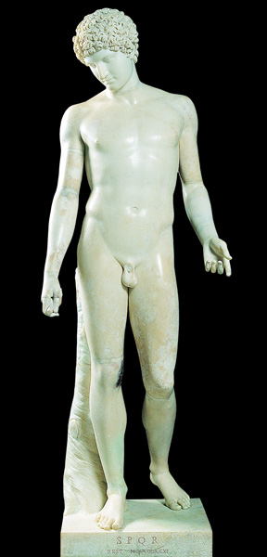
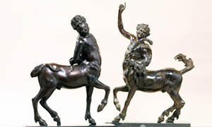
CAPITOLINE ANTINOUS
YOUNG CENTAUR AND OLD CENTAUR

Slide 11
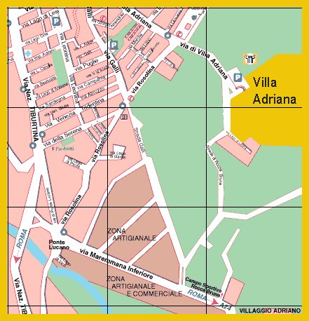
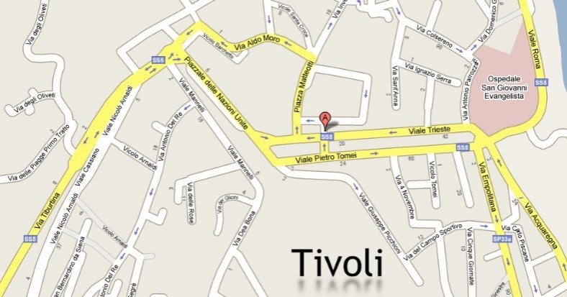
PRESENT-DAY SIGNIFICANCE
Hadrian's Villa is a UNESCO World Heritage Site and important cultural and archaeological site. It is also a major tourist destination along with the nearby Villa d'Este and the town of Tivoli. The Academy of the villa was placed on the 100 Most Endangered Sites 2006 list of the World Monuments Watch because of the rapid deterioration of the ruins.

Slide 12
GLOSSARY:
Elongated fountain
Courtyard
Main residential
Travertine
Brick
Lime
Pozzolana
Tufa
Marble
Arcade
Vault
Pillars
Ring-shaped
Heated baths
Washbasin
Domes
Steam baths
Apex
Fontana allungata
Cortile Principale complesso residenziale Travertino Mattone Calce Cenere vulcanica Tufo Marmo Galleria, porticato, arcata Volta, cripta, tomba Pilastri A forma di anello Bagni riscaldati Lavabo Cupole Bagni di vapore Apice
Realizzato da: Francesca Colucci, Marialuisa Brovida, Gaia Portaleone, Giulia Forte ed Elena De Vuono. Classe II A

