Slide 1
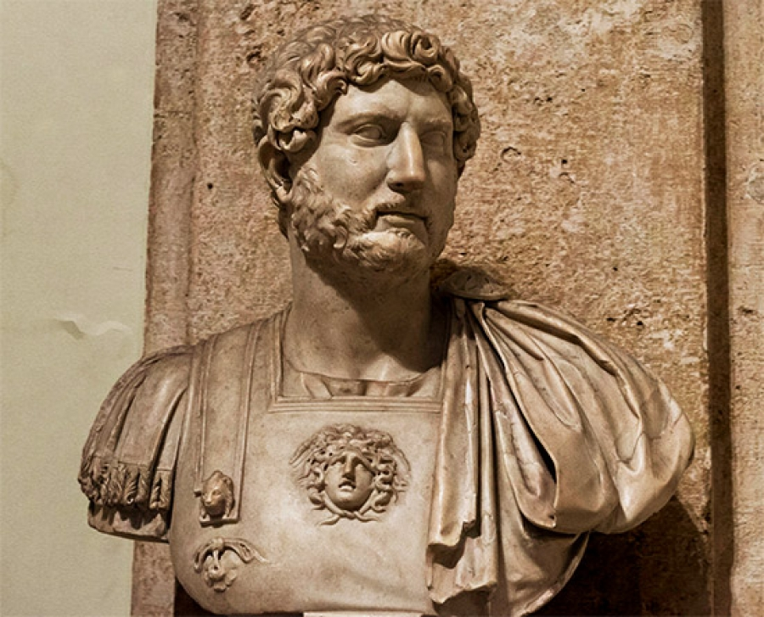
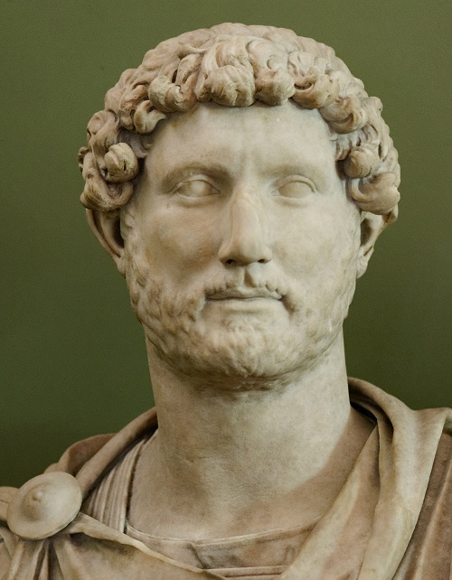
EMPEROR HADRIAN

Slide 2
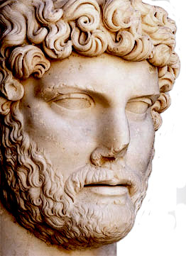
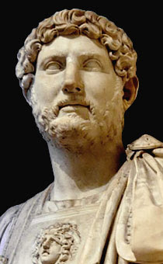
Hadrian was declared emperor in AD 117 after the death of Trajan, who had been his mentor. He was forty years old when he ascended the throne. He decided to resolve those military problems left open by his predecessor.

Slide 3
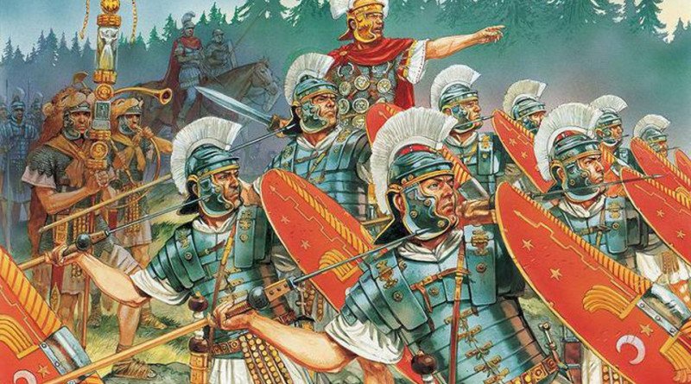
Hadrian’s strategy was different from that of Trajan in that he chose to contain and defend the existing boundaries of the empire instead of concentrating on great projects of battle. He took in creating a good, efficient bureaucratic organization of the State. Four years after his coronation, he began to inspect personally the provinces of the empire taking long trips which lasted years.

Slide 4
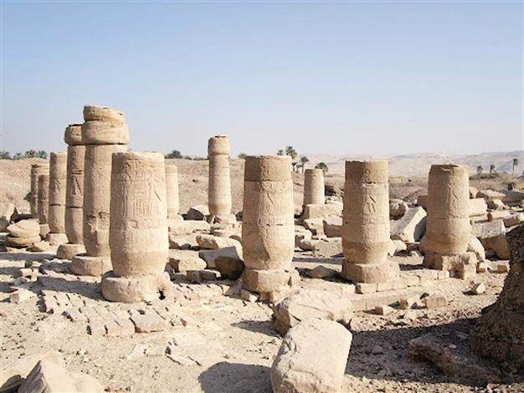
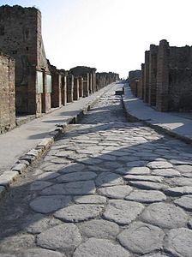
He was a man of peace and an acute observer of situations. Where necessary, he led the garrisons into victorious battles and studied all the necessary logistics with experts. He built bridges and roads in Gaul, reorganized the garrisons in Germany and constructed a great defensive valley in Brittany. In Egypt, he constructed Antinopolis, a city on the Nile.

Slide 5
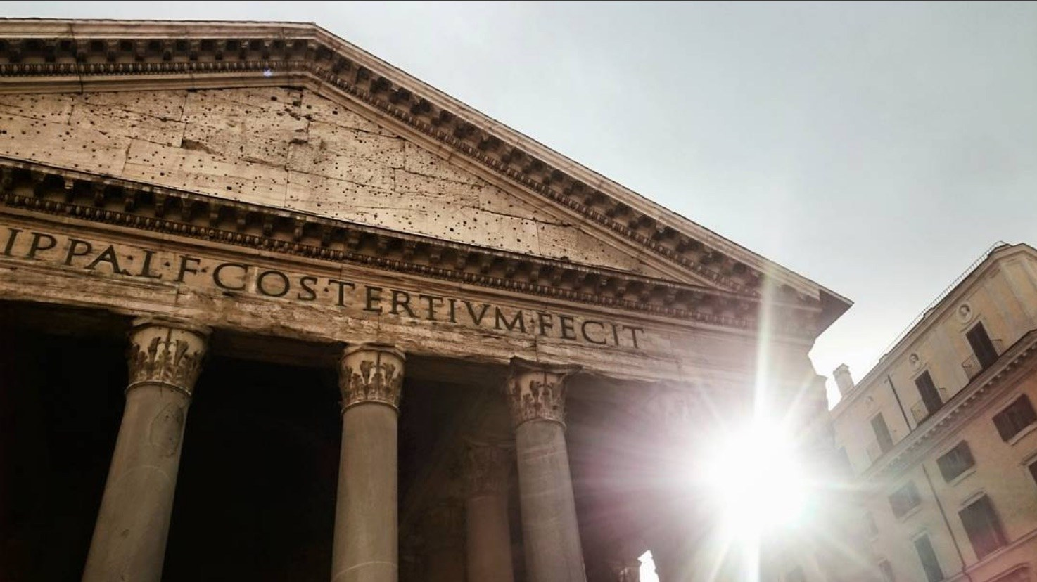
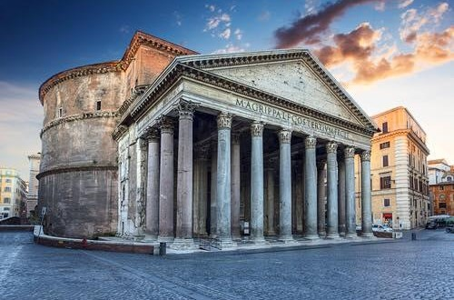
Among the great construction projects in Rome for which Hadrian is responsible are the rebuilding of the Pantheon after its destruction by fire, and the construction of the villa near Tivoli, a masterpiece for its architectural riches and imagination.

Slide 6
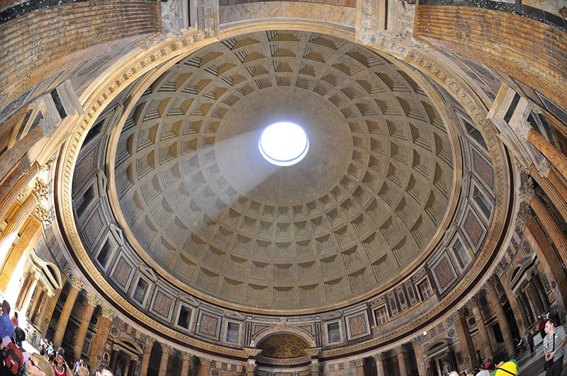

Slide 7
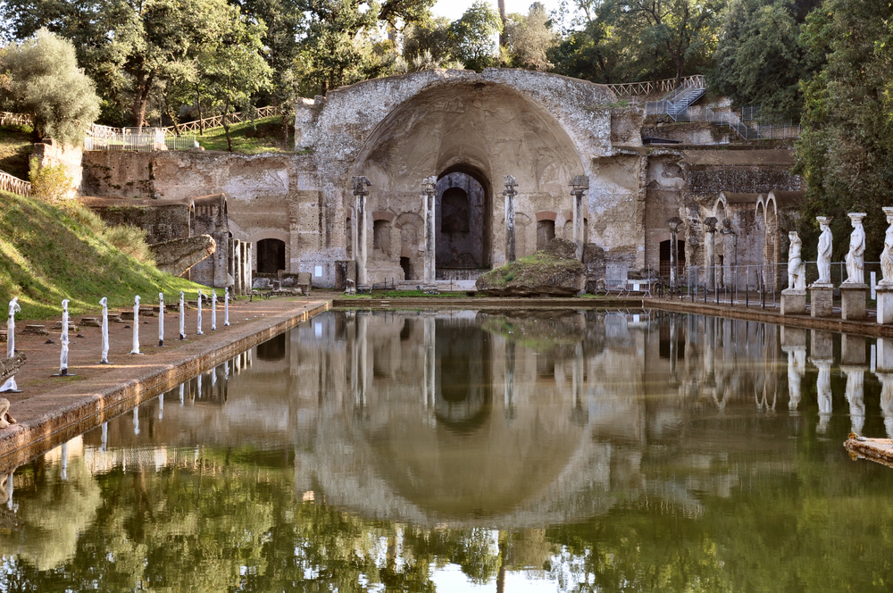
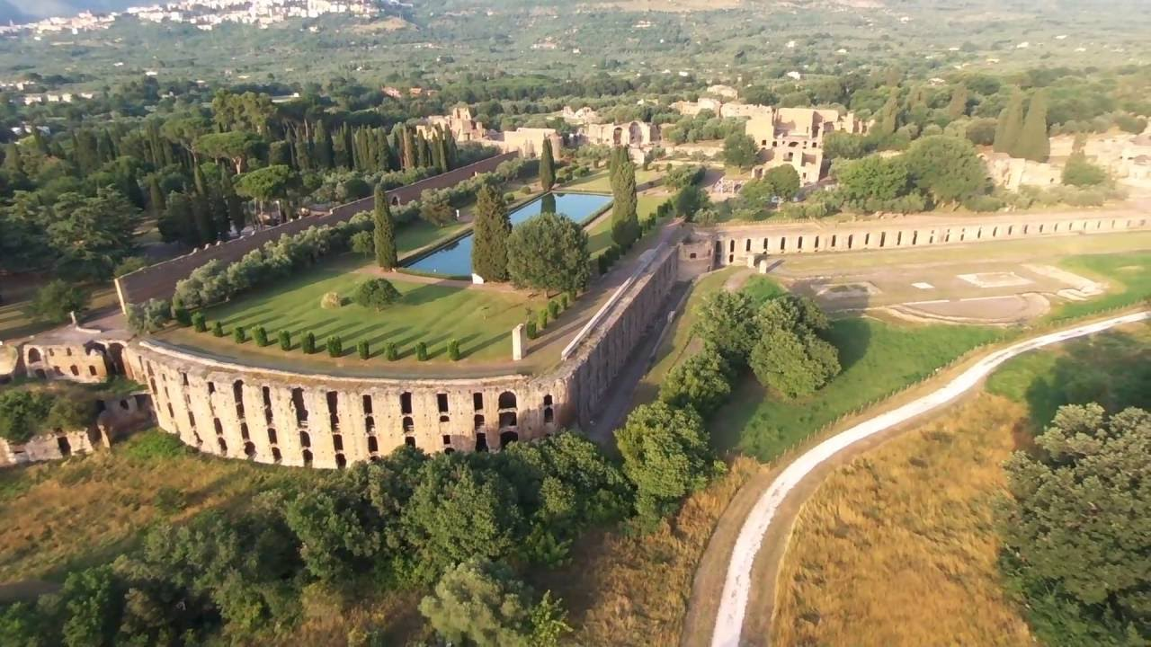
In this splendid residence which was developed around an already existing building, the emperor spent the last years of his rule, dedicating his time to meetings with philosophers and intellectuals, entertaining them hospitably and discussing various topics with them.

Slide 8
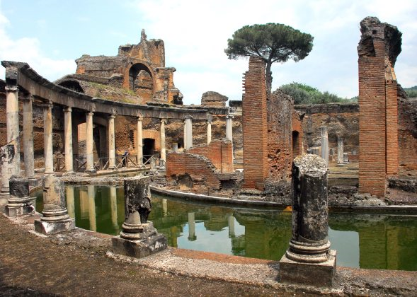
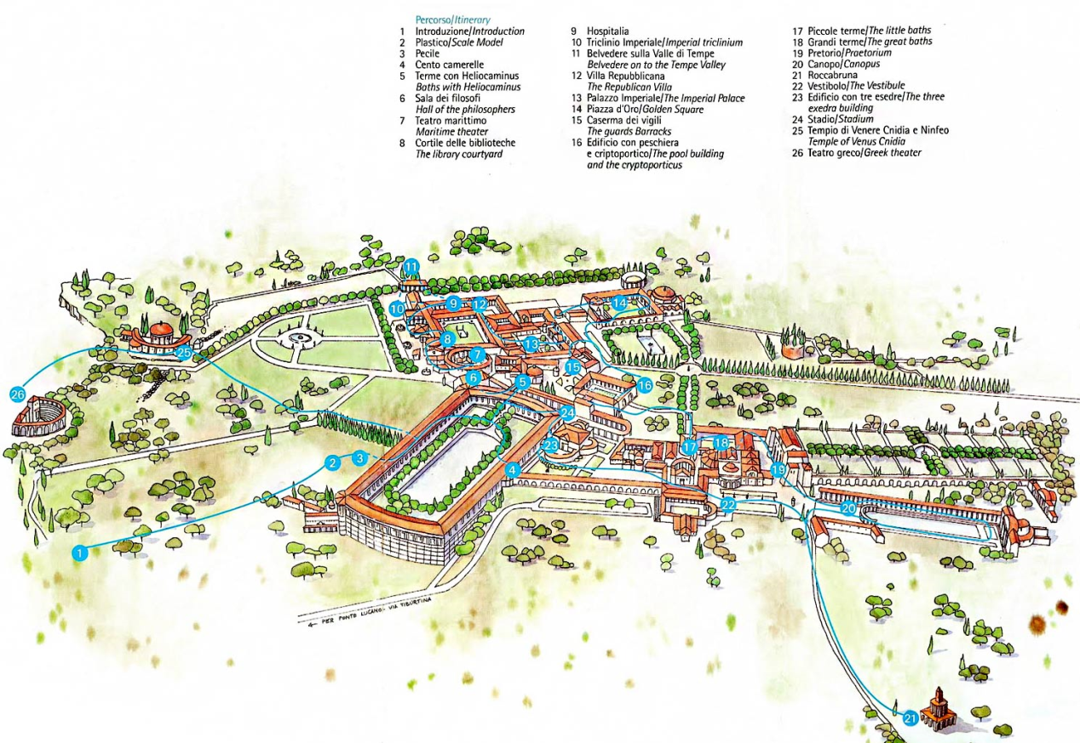

Slide 9
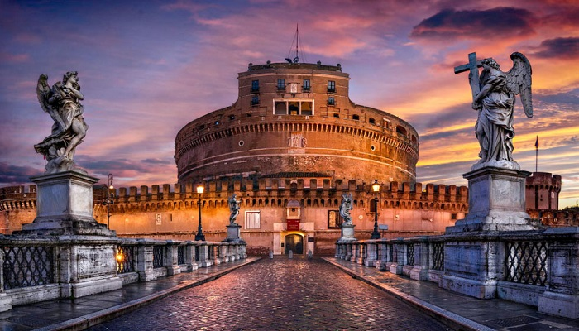
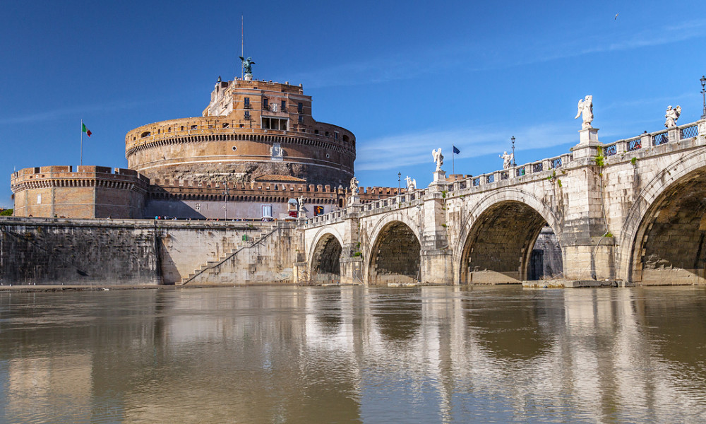
While still living, Hadrian wanted to oversee the construction of his own tomb ( the great mausoleum which today is Castel Sant’Angelo), and had it placed on the right bank of the Tiber with a bridge ( Ponte Elio) constructed just to reach it.

Slide 10
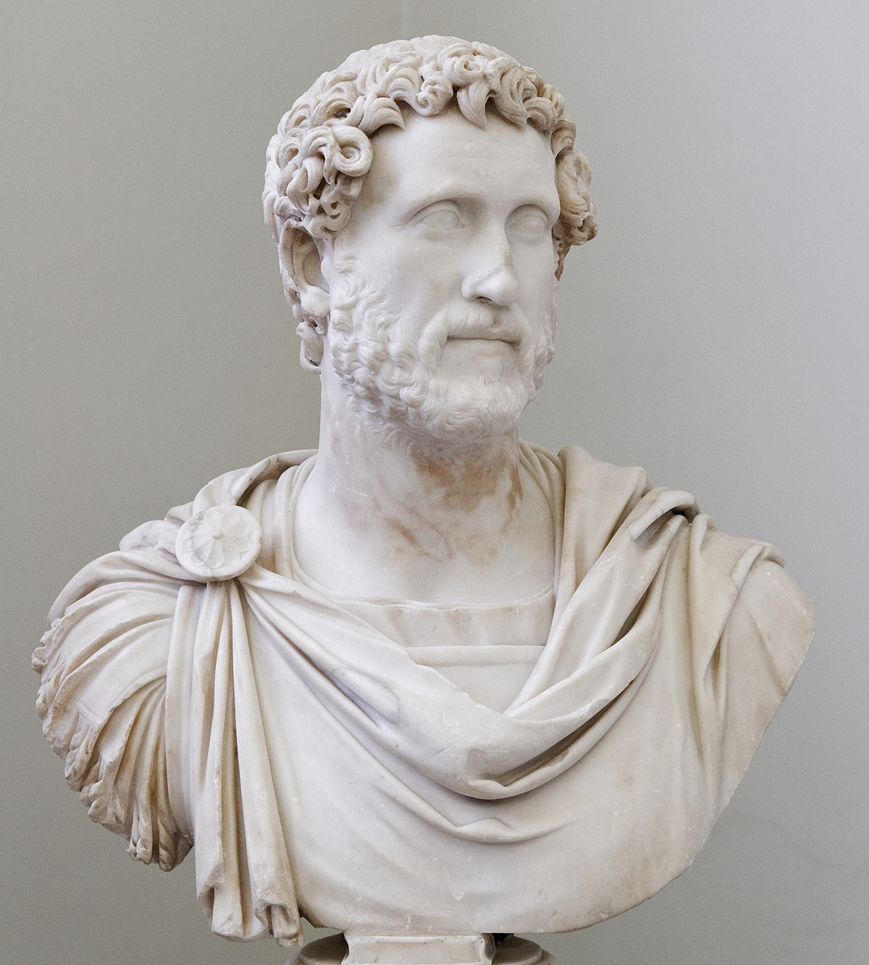
ANTONINO
Hadrian died in AD 138 at the age of 62, and nominated as his successor Antonino, leaving him a consolidated and prestigious empire.

Slide 11
This project was created byꓽ
° Carmen Barone
° Rebecca Castelnuovo
° Benedetta Faieta
° Rossella Florio
° Rebecca Mileti
IIA
23/05/2018

