Slide 1
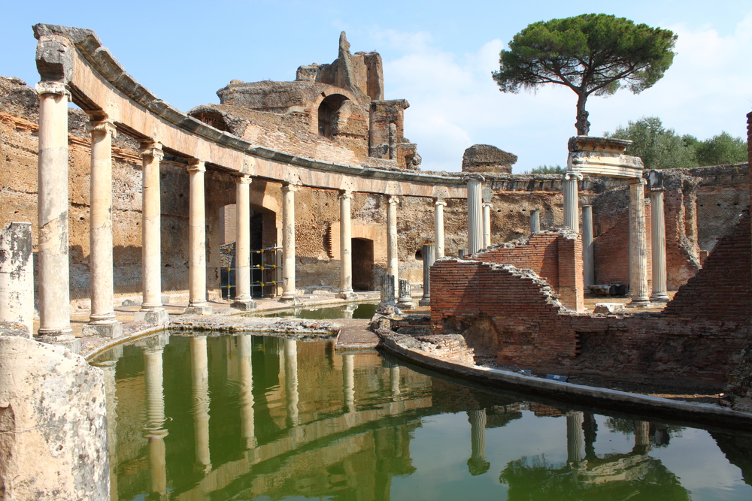
BROCHURE VILLA ADRIANA

Slide 2
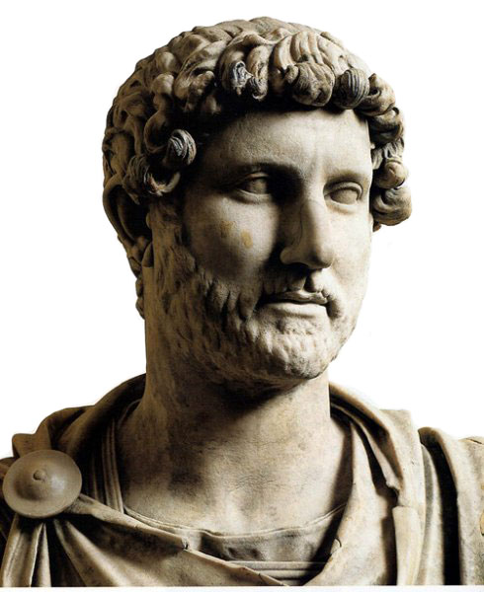
EMPEROR HADRIAN
Hadrian was declared emperor in AD 117 after the death of Trajan,who had been his mentor.Originally from Spain ,he was a man of peace and an acute observer of situations. Hadrian was to spend more than half his reign outside Italy.

Slide 3
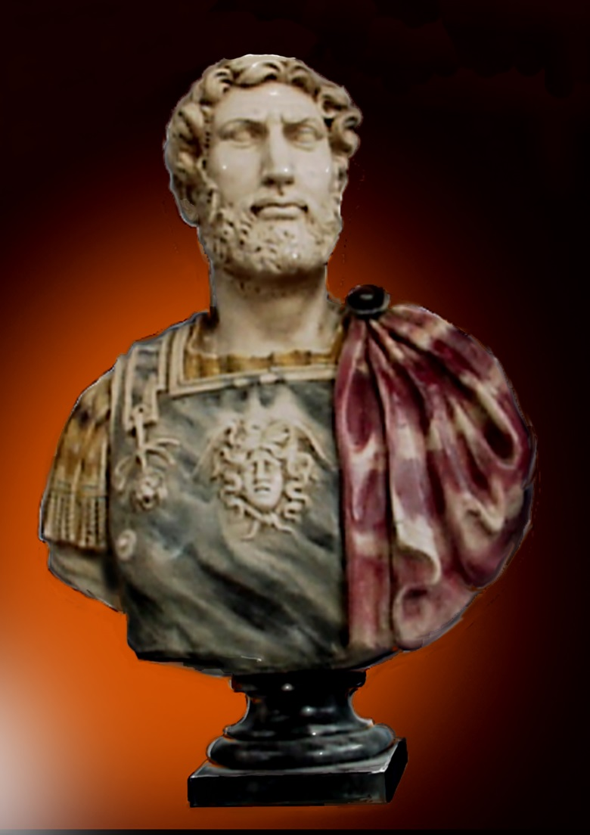
Hadrian was a cultured and refined man,lover of Greek culture, in fact he spent long periods in Greece.
Hadrian died in AD 138 at the age of 62 ,and nominated as his successor Antonino , leaving him a consolidated and prestigious empire.

Slide 4
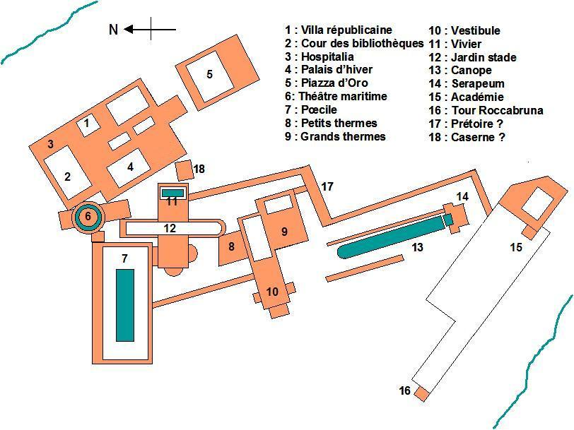
MAP OF HADRIAN’S VILLA

Slide 5
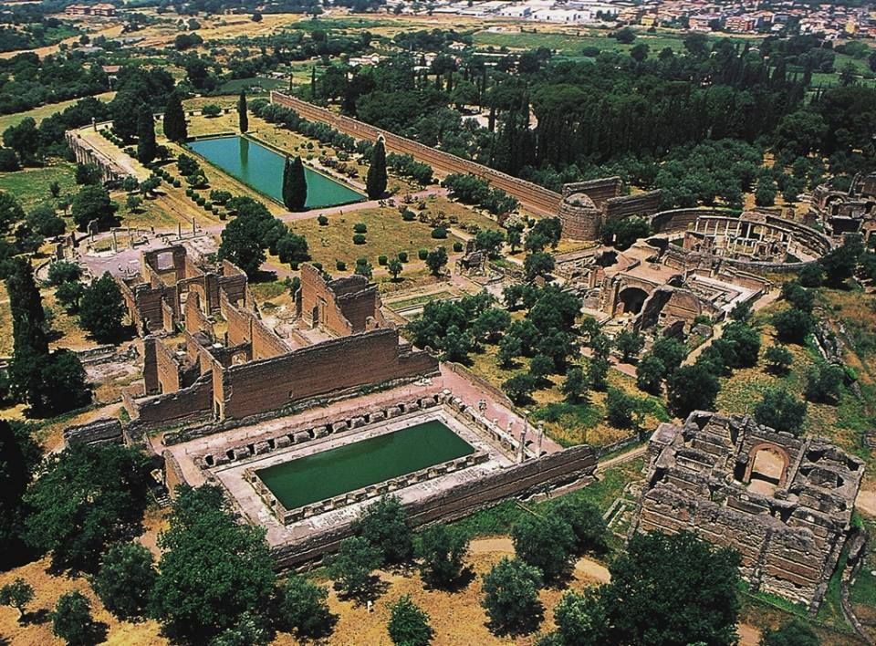
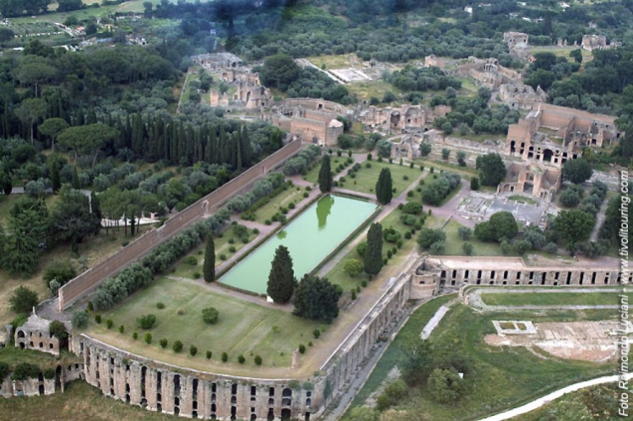
hadrian’s villa
Hadrian’s villa in Tivoli bears witness to the grandeur of the Roman Empire.
It is one of the best kept and most visited archeological sites in Italy.This is why it has been listed as a UNESCO World Heritage Site since 1999.
The villa was built by Roman Emperor Hadrian at the foot of the Tiburtine Hills between 118 and 138 AD.

Slide 6
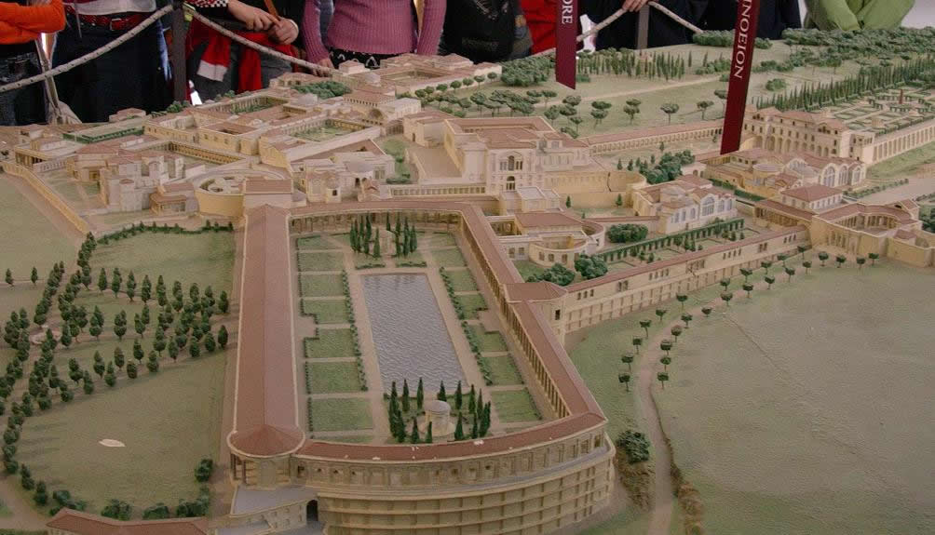
the structure
The vast residential complex extended over an area of about 120 hectares. The site included buildings,baths,temples, barracks,theatres,gardens,fountains and nymphaeums.Today,of the ancient pomp,it is possible to see only 40 hectares.Some parts were explicitly commissioned by Hadrian to represent tht empire’s many provinces that he had visited himself.

Slide 7
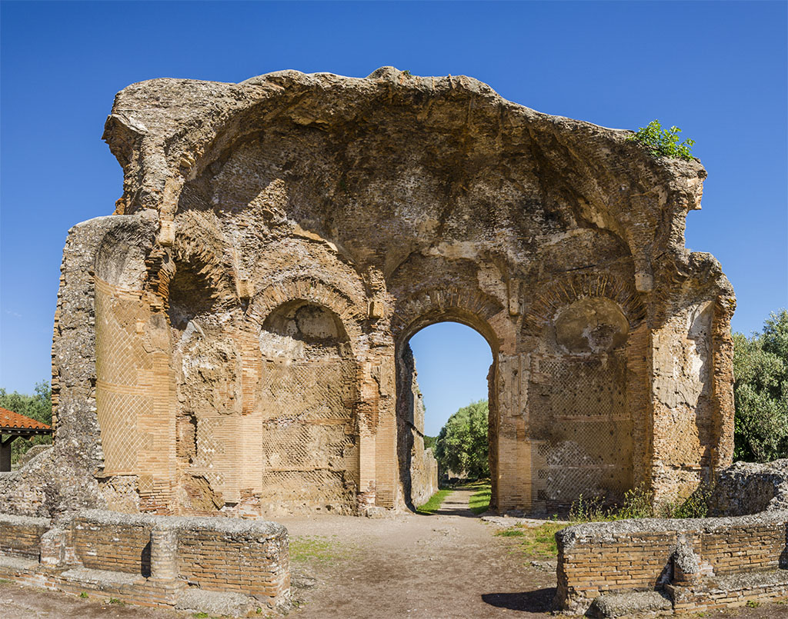
The Vestibule, which connected the Great and Small Baths.

Slide 8
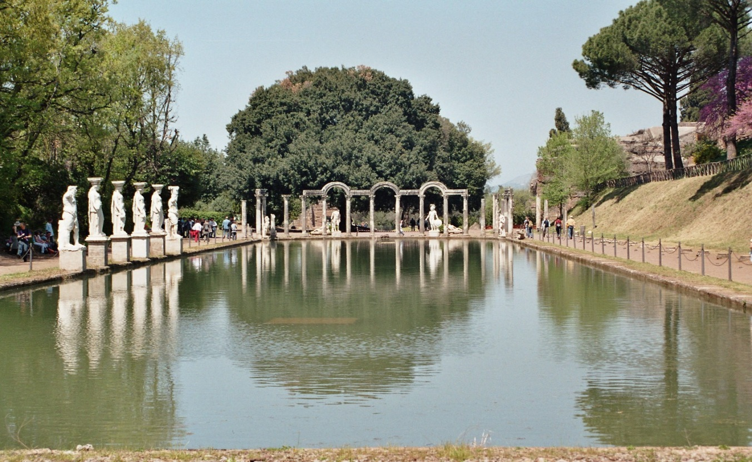
The Canopus, a long canal lined by columns of carytids in homage to the ancient Egyptian city of the same name.

Slide 9
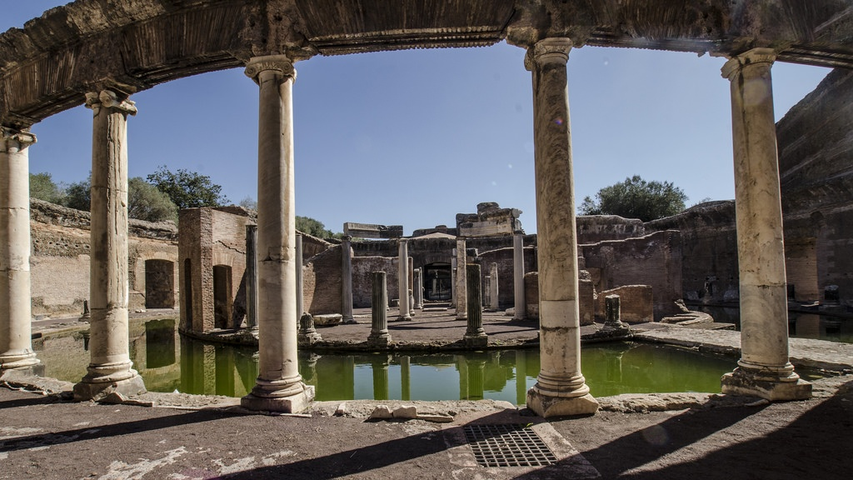
The Maritime Theatre, a portico which contained a round pool representing the sea.

Slide 10
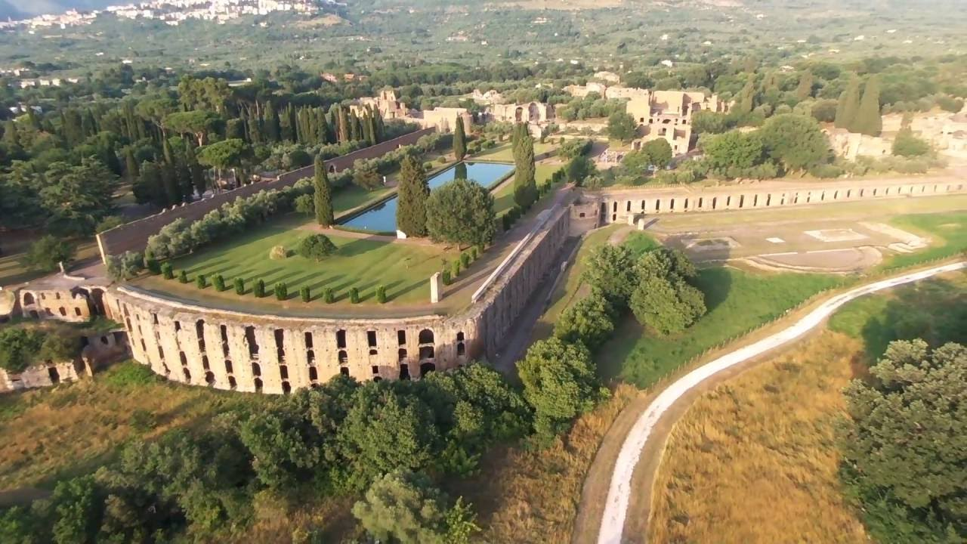
The Pecile a long covered portico once used for panoramic strolls.

Slide 11
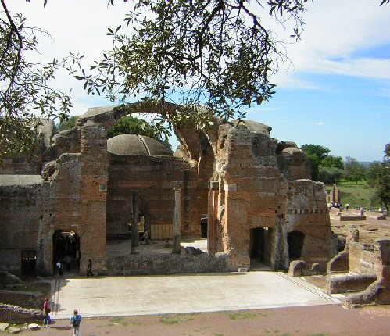
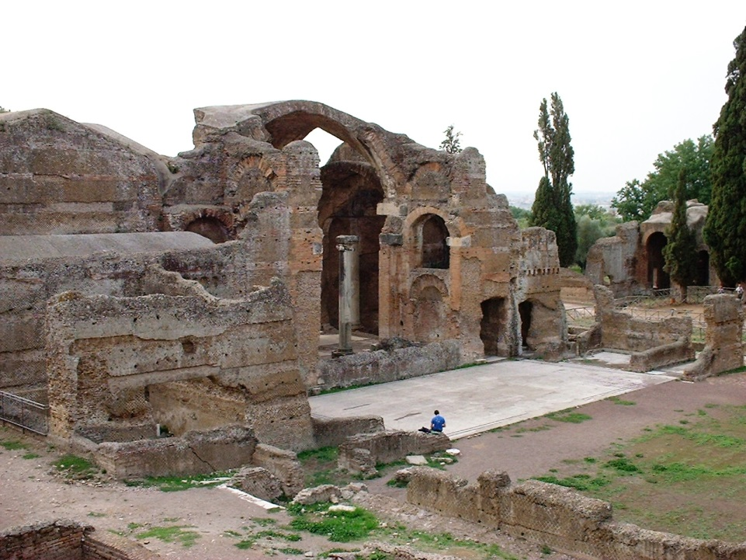
The Great and Small Baths , places where endless days would be spent on wellness.

Slide 12
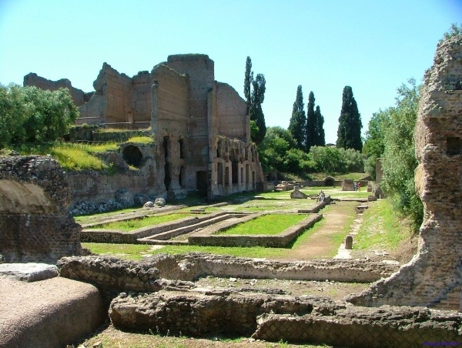
The Greek Theatre , a small court theatre reserved to only a few guests.

Slide 13
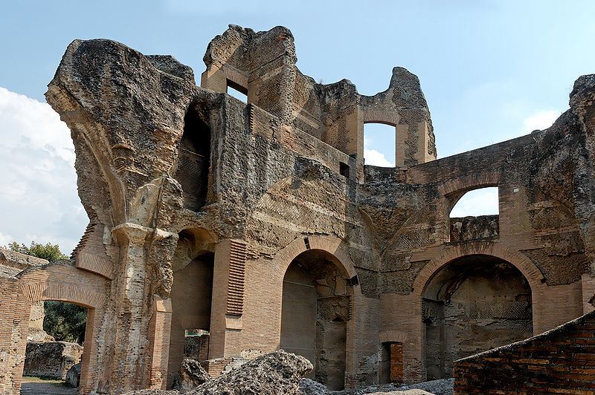
The Greek Library and Latin Library , repositories of knowledge.

Slide 14
Duration of the tour 1h and 30 Address Largo Marguerite Yourcenar,1-00019 , tIVOLI. Tickets Standard Ticket 8.00 Reduced Ticket 4.00,with events 11.00 Tickets Information 0774382733 Telephone 0774530203

Slide 15
Opening hours
- 9 am to -5pm from 2 January to 31 January,last admission at3.30 pm.
- 9 am to 6 pm from 1 February to 29 February,last admission at 4.30 pm.
- 9 m to 6.30 pm from 1 March to the last Saturday of March,last admission 5pm.
- 9 am to 7 pm from the last Sunday of March to 30 April,last admission 5.30 pm.
- 9 am to 7.30 pm from 1 May to 31 August,last admission 6 pm.
- 9 am to 7 pm from 1 September to 30 September,last admission 5.30 pm.
- 9 am to 6.30 pm from 1 October to last Saturday of October ,last admission 5 pm.
- 9 am to 5 pm from the last sunday of October to 31 December,last admission 3.30 pm.
THE VILLA IS OLSO OPEN ON MONDAYS.

Slide 16
tips for tourists
-Bring a hat to cover yourself from the sun.
-Bring a packed lunch.
-Bring an umbrella in case of rain.
-Do not leave waste around.

