Slide 1
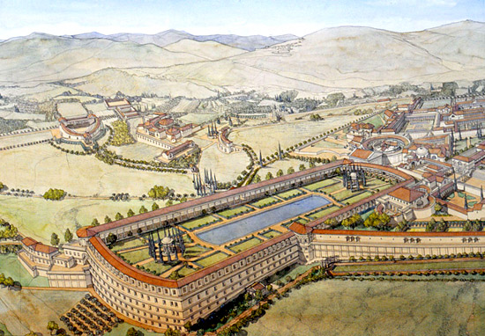
STRUCTURE OF HADRIAN’S VILLA

Slide 2
Why did Hadrian build the villa?
There are lots of reasons why the emperor Hadrian build that huge villa. For example, many sustain that he built the complex to be far from the rich aristocracy and from the Senate, which suspected him of having ordered the killings of a lot of contenders for the throne. Actually, as we know, he decided to edify that giant villa to manage the Roman empire better.
He also thought the structure as a place of rest, to be far from the chaos of Rome. Unfortunately, he couldn't always relax here, because of the eternal working of the slaves (see the barracks where the thrall had to sleep), in fact the villa was totally finished only after twenty years c.! So he "hid" the slaves with a big system of connections, that is considered the first subway of the story. The time was very long, but the results are clearly visible today.

Slide 3
Hadrian's Villa
The Hadrian's villa was a sumptuous complex over 30 buildings, covering an area of latest 100 hectares, built (C.124-134CE) at Tivoli near Rome.
The complex was an imperial garden city, because it was the greatest Roman example of an Alexandrian garden, recreating a sacred landscape; its buildings were designed to follow the natural lay of the land.

Slide 4
Architectural styles
The villa shows different architectural styles, mostly Greek and Egyptian. Hadrian, was a very well-traveled emperor that borrowed these designs, such as the caryatids by the Canopus, along with the statues beside them depicting the Egyptian dwarf and fertility god.
The domes of the main buildings as well as the Corinthian arches of the Canopus and Serapeum show clear Roman architecture. According to Hdrian's biography, we know that he designed the complex's structure based on the complexes he saw during his travels.

Slide 5
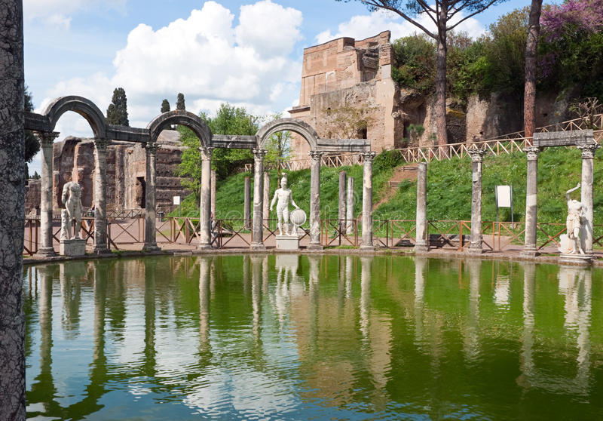
AN IMAGE OF THE CANOPUS.

Slide 6
The Pecile
Hadrian's another structure of ancient Greece that we find in Villa Adriana is the Pecile which is located inside the Villa. It was a huge garden surrounded by a swimming pool and an arcade.
The pool's dimensions measure 232 by 97 metres (761 by 318 ft). Originally, the pool was surrounded by four walls with colonnaded interior. These columns helped to support the roof.
The northern part, where there is an entire wall of thorn, 9m. high , was made up of a double portico, with laurel plants cut into cylinders. This part of the portico made it possible to walk both in the winter and in the summer, and with a complete path around the wall of thorn, on this side a distance of approximately 429 m could be reached.

Slide 7
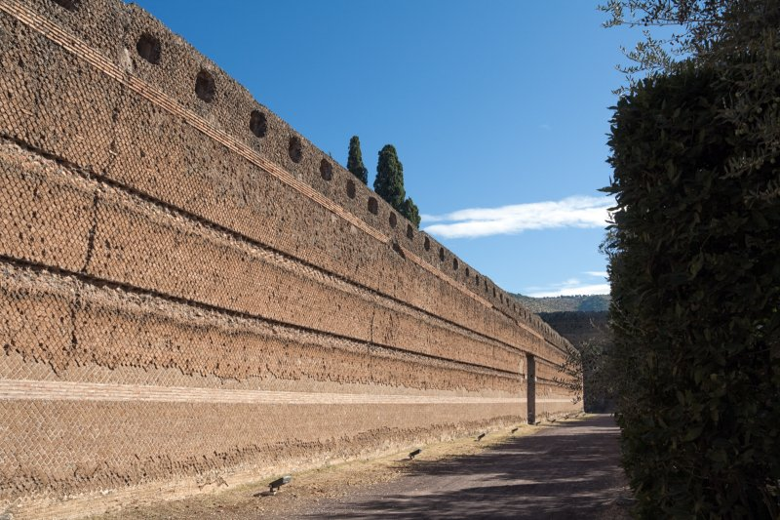
AN IMAGE OF PECILE.

Slide 8
The Maritime Theatre
The last Greek structure present in the villa is the so-called"Maritime Theatre". It consists of a round portico with a barrel vault supported by pillars. Inside the portico was a ring-shaped pool with a central island.
The Maritime Theater includes a lounge, a library, heated baths, three suites with heated floors, washbasin, an art gallery, and a large fountain. On the island sits a small Roman house complete with an atrium, a library and small baths. The area was probably used by the emperor as a retreat from the busy life at the court.

Slide 9
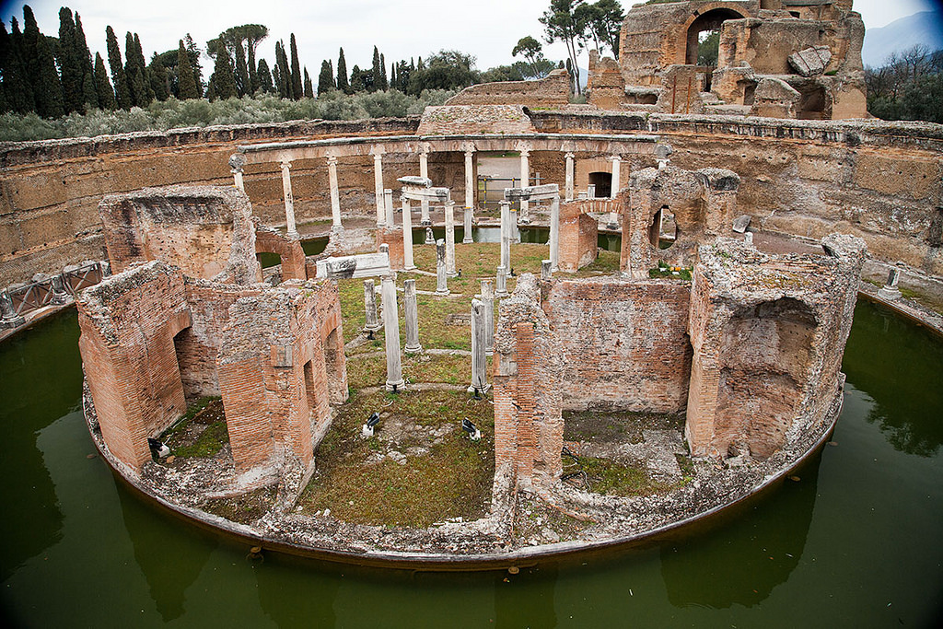
ORIGINALLY CONNECTED BY TWO REVOLVING WOODS STRUCTURES

Slide 10
Thanks
for
attention!!!
This powerpoint was written by: Francesco Pio Di Rocco, Mario Paladino, Tiziano Pecorella.

Slide 11
GLOSSARY
huge: Extrimely large, grandissimo.
Emperor: imperatore.
Empire: impero.
Thrall: schiavo.
Subway: metropolitana.
Sumptuous: suntuoso.
Hectares: ettaro, unità di misura dell’area.
Landscape: paesaggio.
Well-traveled: viaggiare molto.
Caryatids: cariatide, figura femminile scolpita usata come pilastro.
Domes: dome, cupola.
Arches: arch, arco.
Surrounded: circondato.
Depicting: raffigurante.
So-called: cosiddetto.

