Slide 1
Performance enhancing drugs: nectar or poison? Made by: Beato, Scalella, Coccia, Ludovico

Slide 2
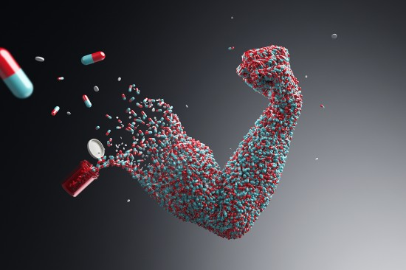
What is doping?
Used in the field of competitive sportsplay, “doping” represents the act of using external substances in order to increase an athlete’s performances and abilities.
This term appeared in the late 20th century, but we have evidence of people like the Ancient Greeks using outside “help” in competitions such as the Olympics.

Slide 3
But are they legal?
Well, yes: but not always.
An athlete’s doctor may ask them to intake some performance enhancing drugs: but they are administered in very small doses, so it can help them recover after an accident, for example.
But it’s not always like that. Sometimes the athletes decide to take them without asking for permission, and they usually utilize bigger doses than recommended.
This is what makes all the difference.

Slide 4
How do they work?
Here are some examples:
Anabolic drugs make muscles bigger; examples include steroids hormones, for example human growth hormone, otherwise known as somatotropine.
Stimulants improve focus. Low doses of stimulants also help cognitive and athletic performance, by improving muscle strength and endurance while decreasing reaction time; a famous example of athletic performance-enhancing stimulant is caffeine, contained in a number of beverages like coffee and tea.

Slide 5
Normal vs. Anabolic Training
Normally, when someone starts training, their muscles are weak: but as that person keeps training, their muscles get stronger.
This happens because their actions slightly damage their muscular tissue, which however grows back after a few days in a much stronger and more flexible form.
Instead, after regular use of anabolic substances, the process of muscle regeneration becomes much faster, letting the athlete train more and making that training far more effective.
This seems like an obvious win for steroids. Why wouldn’t you want to use substances that make you stronger, faster and more resistant?

Slide 6
The consequences of abusing them
In sports where much physical strength is used, athletes use anabolic steroids, known for their ability to increase physical strength and muscle mass. While not as life-threatening as the drugs used in endurance sports, anabolic steroids have negative side effects, including:
Side effects in men:
acne
impaired liver function
impotency
breast formation
increase in estrogen
male pattern baldness
Side effects in women:
hair loss
male pattern baldness
hypertrophy of the clitoris
irregularities of the menstrual cycle
development of masculine facial traits
increased coarseness of the skin

Slide 7
But wait, there’s more!
Psychological damage caused by performance enhancing drug abuse:
Increased aggressiveness and sexual appetite, sometimes resulting in abnormal sexual and criminal behavior, often called “Roid Rage”;
Manic behavior, allucinations/delusions, irregular weight gain/loss;
Withdrawal from anabolic steroid use can be associated with depression due to the athlete’s organism feeling like it needs the substance more than anything (due to its prolonged abstinence from it), and in some cases, suicide.

Slide 8
What do the scientists say?
On regards of a controversial topic, the experts hold many views:
Some scientist are adamant about the lethality of such substances, since it has been proven time and time again that those who abuse them oftentimes do end up in hospitals due to recurring tumors and cancer. Worse, they could end up six feet under.
However, others suggest that these happenstances only surface because said athletes misuse the aforementioned substances. Many others intake them in much smaller doses, preventing their negative effects from taking place.

Slide 9
In conclusion
Wether it is from a moral, medical or even personal standpoint, nobody is certain about the usage of performance enhancing drugs.
Some say they kill you in the long run, some say they’re 100% safe.
Some suggest they are ethically and morally fair, while several individuals claim otherwise.
In regards of such topics, the choice is yours to make.
Time will prove one side wrong.

Slide 10
Fin

