Slide 1
The five senses
Touch – hearing - Olfaction – Sight – Taste

Slide 2
The sense of touch
Touch or tactile sensitivity is one of the five senses. Its purpose is to detect precisely all stimuli from the outside world, or rather : heat, cold, pressure variation and pain.
How does it work?
Under the outermost layer of skin, the epidermis, there is a deeper layer, or the dermis can be found in many receptors and nerve endings. Both are located evenly throughout the body, but in greater quantities in the lips, in the fingertips and the soles of the feet. These areas are therefore more sensitive to external stimuli.

Slide 3
THE SKIN
The skin is the largest lining of the human body, it occupies less than 2 square meters of surface. In humans is thicker in males than in females and the thickness can range from 0.5 mm to 2 mm up to 4 mm in the neck regions, the palms of the hands and soles of the feet. It has a large distensibilily and resistance since a strip of 3 mm to 100 mm can withstand up to 10 kg, reaching about 50%.

Slide 4
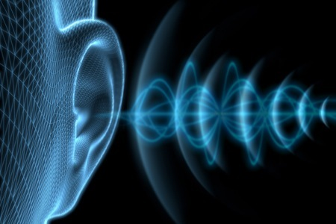
Hearing
The auditory system (more simply hearing) is the first of five sense organs to develop in the fetus and to promote contact with the external environment. The system includes the sensory organs (ears, bodies involved in the perception and sound translation), both parts of the auditory sensory system. Is divided in:
Peripheral auditory system
Central auditory system

Slide 5
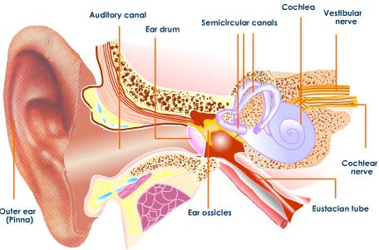
The ears
The ears are the sensory organ of hearing. Ears are divided in three parts:
Outer ear, there is only the ear (pinna)
Middle ear, here there are three important bones (hammer, anvil and stirrup)
Inner ear, cochlea (spiral bone). Inside the cochlea is the organ of Corti.

Slide 6
Olfaction
Olfaction is the sense of smell. It’s operated by the olfactory receptors located in the nasal cavity. It’s the sense that let us perceive the smell of things. It’s one of the main senses in our body that lets us understand better the world around us.

Slide 7
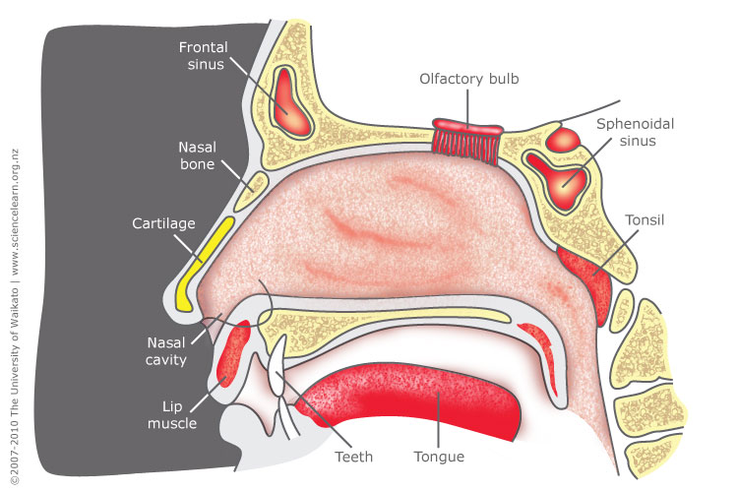
The nose
The nose is the main organ of the olfactory system. It’s located in the middle of the face. Air flows through the nostrils and it gets more humid and warmer, then, oxygen goes to the lungs. The nose has two main functions: It can perceive smells but it’s also fundamental for breathing.

Slide 8
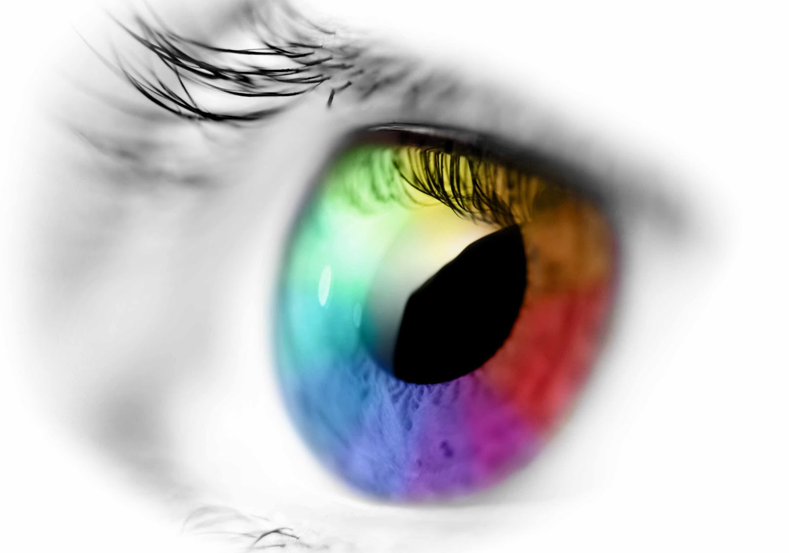
Sight
The sight is one of the five senses through which it is possible to perceive the figures, colors, measures and the position of the objects.
Sight is a very important sense for man, because we take about 80% of the informations of our ambient by it.

Slide 9
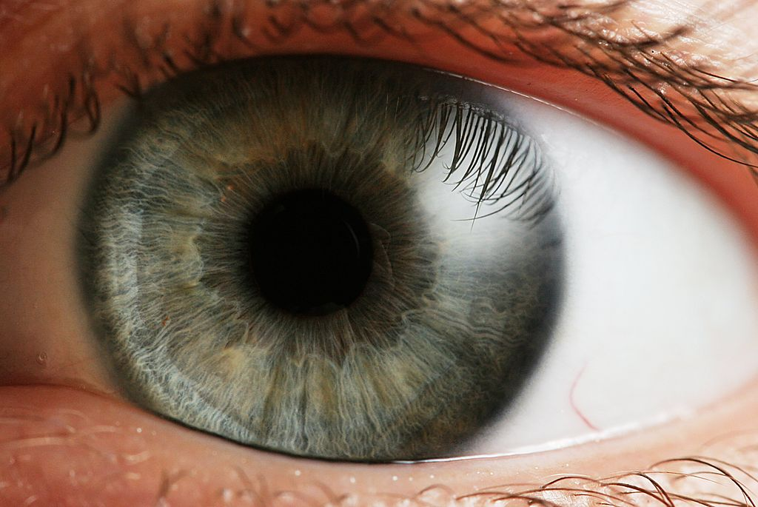
The human eyes
The eye, or eyeball, is the most important organ of the visual apparatus.
It takes information on the surrounding
environment. It takes the light of the environment, it regulates the intensity through iris diaphragm, it focuces light through a adjustable lens system to form image on the retina and it transforms this image into a series of electrical signals that are sent to the brain for processing and interpretation.

Slide 10
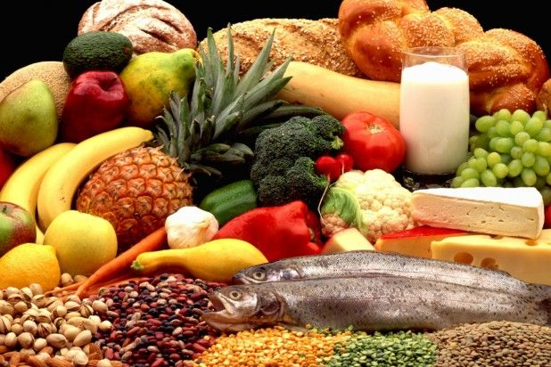
THE TASTE
The taste is the specific sense that thanks to him, it’s recognized and checked the flavor of the substances that are introduced in the mouth. The taste’s organs are made of special structures, called «taste buds», that are cointained in the taste buds: between the different varieties of cell that make the buds; they react to some chemical stimuli that are the 4 flavors (bitter, sweet, salty and acid). Every fiber afferent receives information from some taste buds and the information are introduce in the brain where the central neurons decipher the feeling you get.

Slide 11
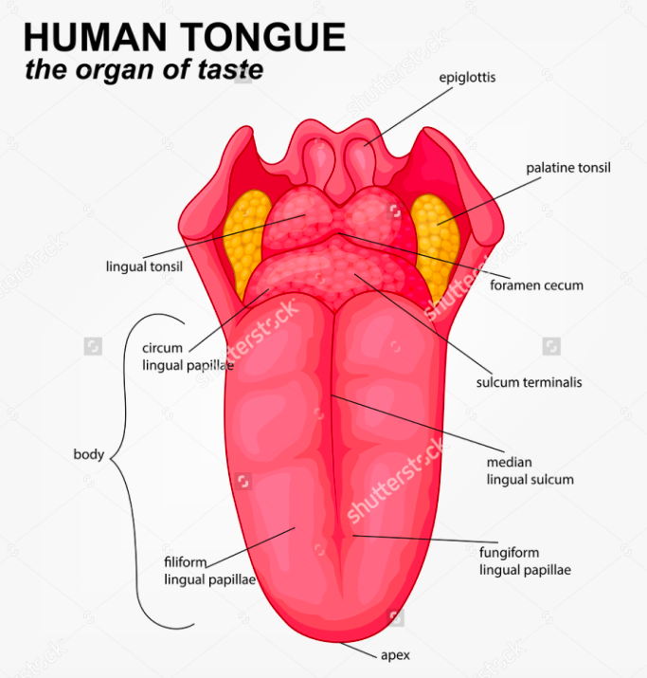
THE TONGUE AND THE FLAVORS
The otgan of taste sensitivity is the tongue, with a tactile and taste function, and it also has an important part in the chewing, in the swallowing and in the language: under the anatomical aspect, is a muscolar organ, coated of mucosa, movable and it’s on the rear of the mouth. On this muscle lie the taste buds that are to react to different flavors:
Sweet
Salty
Acid
Bitter
Umami
The sensitivity to the flavors is spread across the tongue and in other parts of the mouth as the palate and the epiglottis.

Slide 12
The End!
Made by Basile Ettore – Colella Davide – Pirro Armando – Valente armando – Sebastiani luigi

