Slide 1
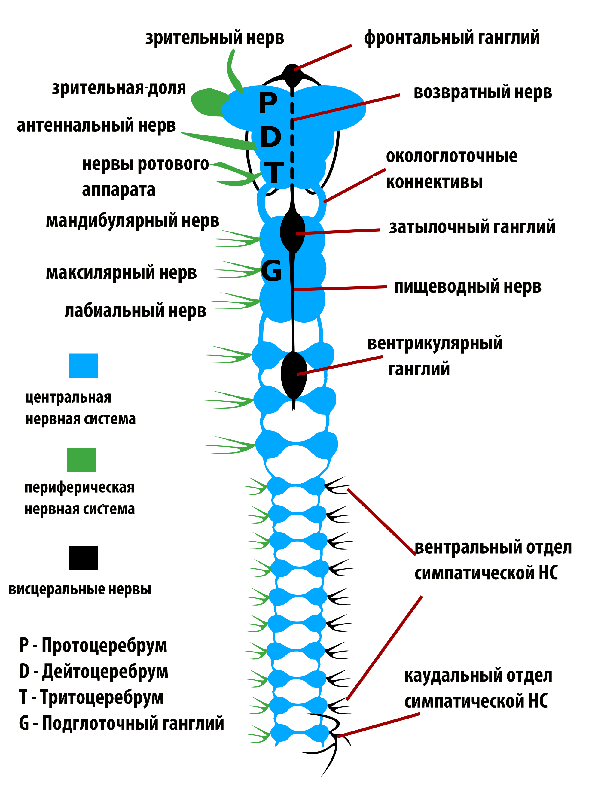
THE NERVOUS SYSTEM
Alessandra Benvenuto
Roberta Candigliota
1^E

Slide 2
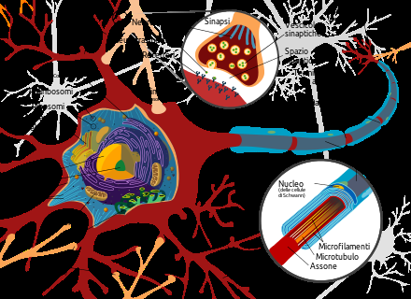
A CENTRAL CONTROL
The nervous system functions as a central control on the outside world and what happens in our body.Its fabric consists of neurons, the specialized cells that can receive and transmit signals throughout the body in the form of nervous pulses.
The nervous system is divided into:
central nervous system that processes information, includes the brain and spinal cord;
peripheral nervous system using the nerves that connect the center with the rest of the body and is divided into somatic and autonomic.

Slide 3
THE ENCEPHALON
The encephalon,contained inside the skull,including the brain,the cerebellum and the medulla oblongata.
The cerebellum, placed in correspondence of the neck, has the function of coordinating the movements and balance;
The medulla oblongata is crucial in the reception of different sensations and control of certain functions related to breathing and circulation;
The brain is the largest part of the brain and is divided into two celebral hemispheres.Both hemispheres are white outside and gray inside.

Slide 4
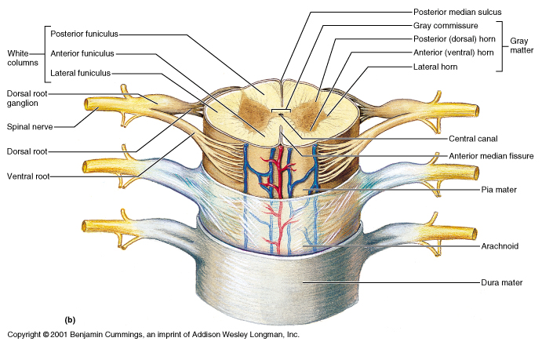
THE SPINAL CORD
The spinal cord is a cord long 50 cm long and 2 cm wide located in the spine and through it passes the sensory nerves, which carry the pulses, and the motor nerves to the muscles carrying orders from the encephalon. It is constituted by a gray and a white substance, with the only difference of having the white substance inside and the gray substance outside.

Slide 5
THE PERIPHERAL SOMATIC SYSTEM
The somatic nervous system,or voluntary,controls the skeletal muscles and the organs of sense.It is formed by:
Cranial nerves that connect the brain to the muscles, to the sense organs and glands;
Spinal nerves that are divided into cervical nerves, thoracic, lumbar and sacral.

Slide 6
THE PERIPHERAL AUTONOMIC SYSTEM
The peripheral autonomic system controls the internal organs that work without our intervention. It is divided into:
sympathetic nervous system which is responsible for mobilizing resources in case of need;
parasympathetic system that deals with the recovery activities.

