Slide 1
The respiratory system
The circulatory system
&
Are two closely intertwined because the oxygenated blood from the lungs with breathing is pumped from the heart to the whole organism

Slide 2
Respiratory system
The most important function that does the respiratory system, in addition to olfactory function and the emission of sounds, is respiratory function that takes the two phases:
Inspiration occurs when air from the external environment, reaches the lungs through Airways due to contraction of intercostal muscles and the diaphragm;
Exhale when the air, carbon dioxide charge, contained in the lungs is always given in external ambietta using the airway
The respiratory system is made up of:
a series of hollow organs, namely, the airway;
two solid organs, lungs.

Slide 3
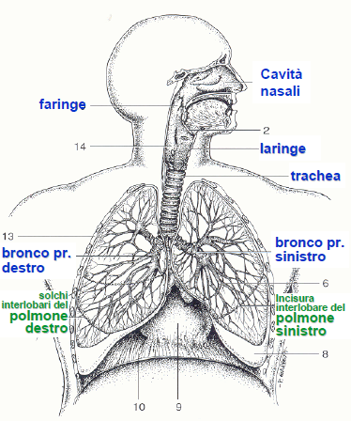
The Airways
Despite being in continuity with each other, are divided into:
upper Airways that are found in the first part of the respiratory system and are the nose, the pharynx and the larynx;
via lower areas that are inside the trachea and the bronchi and the lungs.
nasal cavity
pharynx
larynx
bronchus left
right bronchus

Slide 4
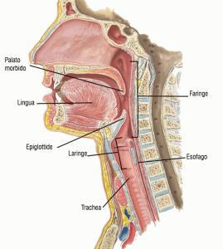
The upper airways: nose, pharynx and larynx
The nose is divided into two parts: the external nose and sinus cavities that are used to enter (oxygen) and Hunt (carbon dioxide);
The pharynx is divided into three parts: upper, middle and lower pharynx. Its main function is to protect the airway as well as the passage of food
The larynx is located between the pharynx and the trachea, also allows air circulation and allows the production of sounds through the vocal cords.
soft palate
pharynx
tongue
epiglottis
larynx
esophagus

Slide 5
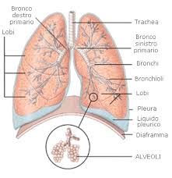
The lower Airways: trachea, bronchial tubes and …
primary right bronchus
trachea
The trachea is the channel of communication between the organs that take up the neck and those residing in the chest.
I bronchi, contenuti nei polmoni, sono la ramificazione della trachea. I bronchi sono un organo fondamentale per lo scambio dei gas durante il processo di respirazione.
lobes
primary left bronchus
bronchi
bronchioles
lobes
pleura
pleural fluid
diaphragm
ALVEOLI

Slide 6
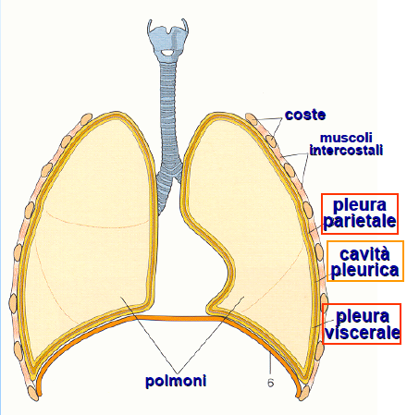
... The lungs
coasts
The lungs are positioned inside the rib cage, so they are protected by the ribs and serve an important function in respiration.
intercostal muscles
parietal pleura
pleural cavity
visceral pleura
lungs

Slide 7
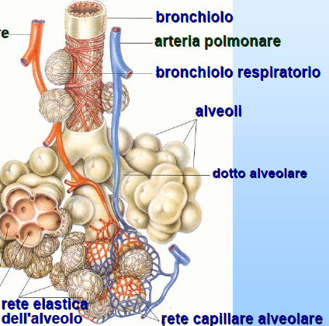
The structure of a lung
bronchiolo
pulmonary artery
Within each lung are the bronchi bronchial tubes that
Branch becoming of the Bronchiolesi. In turn, the Bronchioles undergo various divisions until it reaches the alveoli where the gas exchange
respiratory bronchiole
alveolar duct
grid alveolar
grid alveolar capillary

Slide 8
Diseases of the respiratory system
The Airways and the lungs are target of diseases caused by bacteria, viruses and toxins and also from tumors. You can check both of pulmonary infections of both chronic respiratory diseases.

Slide 9
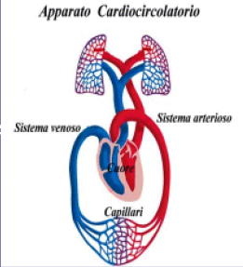
The circulatory system
CARDIOVASCULAR SYSTEM
The circulatory system is the collection of fluid transport organs inside our body. It consists of:
heart whose function is to pump blood into the circulation;
blood vessels (arteries, veins and capillaries) which have the capacity to hold the circle of blood;
blood whose function is to transport oxygen, nutrients and waste products.
arterial system
venous system
heart
capillaries

Slide 10
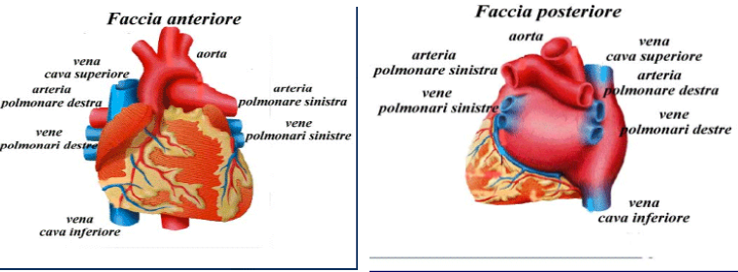
The circulatory system: the heart
The heart is a hollow organ located in the chest between the lungs. The walls of the heart consist of a particular type of muscle, cardiac muscle, said cases, and are covered by two epithelial membranes that have a protective function and are the endiocardo and the pericardium.
Front face
Face back
superior vena cava
left pulmonary artery
superior vena cava
artery
left pulmonary artery
left pulmonary veins
right lung
right lung
Right pulmonary veins
Right pulmonary veins
left pulmonary veins
inferior vena cava
inferior vena cava

Slide 11
The circulatory system: the heart
Inside the heart are distinguished four different cavity:
two upper cavity represented from the right atrium and left atrium;
two cavities below represented from the right ventricle and the left ventricle.
THE OTHERS
Atriums flows the blood.
Ventricles
With the entry of blood the ventricles contract and the valves between the others and the ventricles are closed. From the right ventricle through the pulmonary valve, the deoxygenated blood veins pushed in the pulmonary arteries. The left ventricle pushes oxygenated blood through the aortic valve, in the large artery that starts from the heart.

Slide 12
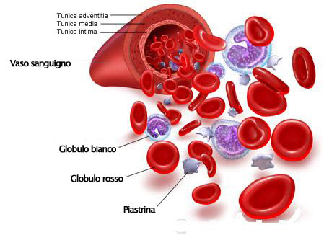
The circulatory system: the blood
The blood circulates cells with specific functions:
red blood cells whose function is to transport oxygen;
white blood cells for defense from extraneous agents;
platelets play an important role in wound healing
blood vessel
white Blood Cell
Red globule
platelet

Slide 13
The circulatory system: the plasma and the figurative elements
The plasma:
consists of 90% water, which contains dissolved substances.
The figurative elements:
red blood cells:
carry oxygen to all tissues of the body. One of the most striking features is the color red, due to the hemoglobin, a large molecule containing iron, and have no nucleus.
White blood cells:
Are responsible for the immune system of organize. White blood cells are often destroyed during an infection
Platelets:
They promote blood clotting and swabs the burst blood vessels.

Slide 14
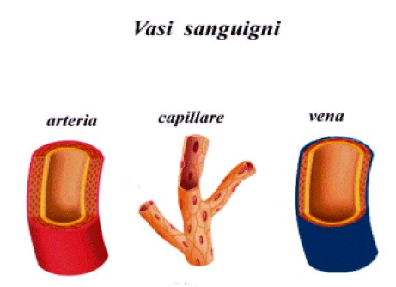
The circulatory system: blood vessels
Blood vessels originate from the heart, and are mandated to carry oxygenated blood and nutrients throughout the body via the arteries, and bring back to the heart through the veins, the blood with carbon dioxide and waste products. Blood vessels give rise to two separate circuits:
-the small circulation;
-the great circulation.
Blood vessels
arteries
capillary
vein

Slide 15
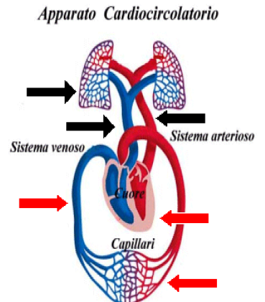
The circulatory system: blood vessels
The small circulation:
The small circulation starts from the right ventricle, from which the pulmonary artery arises. This is divided into two sections that are in both lungs branching into capillaries. These flow into larger pots, until four veins lungs that flow to the left atrium.
The great circulation:
The great circulation starts from the aorta, which through the arterial bed spreads to the whole body. Arteries branch into capillaries, which flows in the veins.
Circulatory System
arterial system
venous system
great circulation
small circulation

Slide 16
Patologie legate all’apparato circolatorio:
-Bradycardia when the heart more slowly than normal and the individual feels fatigued;
-Tachycardia when the heart beats faster than normal;
-Atrial fibrillazone when the Atria contract in a disorderly manner;
-Heart failure when the heart is not working as well as it should and is no longer able to pump sufficient blood to meet the body's needs.
-The heart attack occurs when a heart muscle dies or is permanently damaged because it did not receive enough blood.
The end
Lavoro realizzato da: De Angelis Simone, Lamanda Roberto, Trolio Noemi, Ricci Giuseppe e Pacucci Nicola.

